Slide 1
Experiment 6
Stackelberg competition II – first mover can revise decision
Does your analysis and conclusions above change if the rules of the game are changed as in experiment 6 (producer 1 can revise her quantity while producer 2 decides)? Specifically, does it change the Nash equilibrium when the first mover has the opportunity to revise her decision? Which quantity should the first mover announce? Which quantity should the second mover choose? Should the first mover revise her quantity decision? What should she choose? Is this the only Nash equilibrium in this game? Can you derive the equilibrium mathematically?

Slide 2
Experiment 6
Is having an additional opportunity a good thing?
Not in this case:
the commitment to produce quantity of 500 is credible in experiment 5: the first mover cannot change his decision, thus the second mover has to take it as given
In experiment 6 the commitment is not credible, since the 1st mover can revise it while the 2nd decides
Specifically, the 1st mover thinks what the 2nd mover will answer, and will choose a best reply to that expectation
The 2nd mover will anticipate that and will choose a best reply to this 1st movers behavior
The 1st mover of course will expect that and choose a best response to that
Etc. etc.

Slide 3
Experiment 5
600
600
600
Subgame 2
Subgame 1
Quantity 2 (Quantity 1a)
F₁
Quantity 1a
F₂
F₁
Quantity 1b
0
0
0
Payoffs: f1 (q1b,q2) ; f2 (q1b,q2)
Solve backwards
Firm 1/Firm 2 cannot condition on Quantity 2 / Quantity 1b → simultaneous Subgame 1 → solve with Normal Form
Payoffs do not depend on Quantity 1a → q1a irrelevant

Slide 4
Experiment 5
 | 2nd payoff | Second mover’s best responses
1st payoff |  | 0 |  | 50 |  | 100 |  | 130 |  | 170 |  | 210 |  | 250 |  | 290 |  | 333 |  | 367 |  | 400 |  | 430 |  | 500 |  | 600
First mover | 0 |  | 0 |  | 48 |  | 90 |  | 113 |  | 141 |  | 166 |  | 188 |  | 206 |  | 222 |  | 232 |  | 240 |  | 245 |  | 250 |  | 240
 |  | 0 |  | 0 |  | 0 |  | 0 |  | 0 |  | 0 |  | 0 |  | 0 |  | 0 |  | 0 |  | 0 |  | 0 |  | 0 |  | 0
 | 50 |  | 0 |  | 45 |  | 85 |  | 107 |  | 133 |  | 155 |  | 175 |  | 191 |  | 205 |  | 214 |  | 220 |  | 224 |  | 225 |  | 210
 |  | 48 |  | 45 |  | 43 |  | 41 |  | 39 |  | 37 |  | 35 |  | 33 |  | 31 |  | 29 |  | 28 |  | 26 |  | 23 |  | 18
 | 100 |  | 0 |  | 43 |  | 80 |  | 100 |  | 124 |  | 145 |  | 163 |  | 177 |  | 189 |  | 196 |  | 200 |  | 202 |  | 200 |  | 180
 |  | 90 |  | 85 |  | 80 |  | 77 |  | 73 |  | 69 |  | 65 |  | 61 |  | 57 |  | 53 |  | 50 |  | 47 |  | 40 |  | 30
 | 130 |  | 0 |  | 41 |  | 77 |  | 96 |  | 119 |  | 139 |  | 155 |  | 168 |  | 179 |  | 185 |  | 188 |  | 189 |  | 185 |  | 162
 |  | 113 |  | 107 |  | 100 |  | 96 |  | 91 |  | 86 |  | 81 |  | 75 |  | 70 |  | 65 |  | 61 |  | 57 |  | 48 |  | 35
 | 170 |  | 0 |  | 39 |  | 73 |  | 91 |  | 112 |  | 130 |  | 145 |  | 157 |  | 166 |  | 170 |  | 172 |  | 172 |  | 165 |  | 138
 |  | 141 |  | 133 |  | 124 |  | 119 |  | 112 |  | 105 |  | 99 |  | 92 |  | 84 |  | 79 |  | 73 |  | 68 |  | 56 |  | 39
 | 210 |  | 0 |  | 37 |  | 69 |  | 86 |  | 105 |  | 122 |  | 135 |  | 145 |  | 152 |  | 155 |  | 156 |  | 155 |  | 145 |  | 114
 |  | 166 |  | 155 |  | 145 |  | 139 |  | 130 |  | 122 |  | 113 |  | 105 |  | 96 |  | 89 |  | 82 |  | 76 |  | 61 |  | 40
 | 250 |  | 0 |  | 35 |  | 65 |  | 81 |  | 99 |  | 113 |  | 125 |  | 133 |  | 139 |  | 141 |  | 140 |  | 138 |  | 125 |  | 90
 |  | 188 |  | 175 |  | 163 |  | 155 |  | 145 |  | 135 |  | 125 |  | 115 |  | 104 |  | 96 |  | 88 |  | 80 |  | 63 |  | 38
 | 290 |  | 0 |  | 33 |  | 61 |  | 75 |  | 92 |  | 105 |  | 115 |  | 122 |  | 126 |  | 126 |  | 124 |  | 120 |  | 105 |  | 66
 |  | 206 |  | 191 |  | 177 |  | 168 |  | 157 |  | 145 |  | 133 |  | 122 |  | 109 |  | 99 |  | 90 |  | 81 |  | 61 |  | 32
 | 333 |  | 0 |  | 31 |  | 57 |  | 70 |  | 84 |  | 96 |  | 104 |  | 109 |  | 111 |  | 110 |  | 107 |  | 102 |  | 84 |  | 40.2
 |  | 222 |  | 205 |  | 189 |  | 179 |  | 166 |  | 152 |  | 139 |  | 126 |  | 111 |  | 100 |  | 89 |  | 79 |  | 56 |  | 22
 | 367 |  | 0 |  | 29 |  | 53 |  | 65 |  | 79 |  | 89 |  | 96 |  | 99 |  | 100 |  | 98 |  | 93 |  | 87 |  | 67 |  | 19.8
 |  | 232 |  | 214 |  | 196 |  | 185 |  | 170 |  | 155 |  | 141 |  | 126 |  | 110 |  | 98 |  | 86 |  | 75 |  | 49 |  | 12
 | 400 |  | 0 |  | 28 |  | 50 |  | 61 |  | 73 |  | 82 |  | 88 |  | 90 |  | 89 |  | 86 |  | 80 |  | 73 |  | 50 |  | 0
 |  | 240 |  | 220 |  | 200 |  | 188 |  | 172 |  | 156 |  | 140 |  | 124 |  | 107 |  | 93 |  | 80 |  | 68 |  | 40 |  | 0
 | 430 |  | 0 |  | 26 |  | 47 |  | 57 |  | 68 |  | 76 |  | 80 |  | 81 |  | 79 |  | 75 |  | 68 |  | 60 |  | 35 |  | 0
 |  | 245 |  | 224 |  | 202 |  | 189 |  | 172 |  | 155 |  | 138 |  | 120 |  | 102 |  | 87 |  | 73 |  | 60 |  | 30 |  | 0
 | 500 |  | 0 |  | 23 |  | 40 |  | 48 |  | 56 |  | 61 |  | 63 |  | 61 |  | 56 |  | 49 |  | 40 |  | 30 |  | 0 |  | 0
 |  | 250 |  | 225 |  | 200 |  | 185 |  | 165 |  | 145 |  | 125 |  | 105 |  | 84 |  | 67 |  | 50 |  | 35 |  | 0 |  | 0
 | 600 |  | 0 |  | 18 |  | 30 |  | 35 |  | 39 |  | 40 |  | 38 |  | 32 |  | 22 |  | 12 |  | 0 |  | 0 |  | 0 |  | 0
 |  | 240 |  | 210 |  | 180 |  | 162 |  | 138 |  | 114 |  | 90 |  | 66 |  | 40 |  | 20 |  | 0 |  | 0 |  | 0 |  | 0
Choose 500 – 0.5 Q₁

Slide 5
Experiment 5
 | 2nd payoff | Second mover’s best responses
1st payoff |  | 0 |  | 50 |  | 100 |  | 130 |  | 170 |  | 210 |  | 250 |  | 290 |  | 333 |  | 367 |  | 400 |  | 430 |  | 500 |  | 600
First mover’s best response | 0 |  | 0 |  | 48 |  | 90 |  | 113 |  | 141 |  | 166 |  | 188 |  | 206 |  | 222 |  | 232 |  | 240 |  | 245 |  | 250 |  | 240
 |  | 0 |  | 0 |  | 0 |  | 0 |  | 0 |  | 0 |  | 0 |  | 0 |  | 0 |  | 0 |  | 0 |  | 0 |  | 0 |  | 0
 | 50 |  | 0 |  | 45 |  | 85 |  | 107 |  | 133 |  | 155 |  | 175 |  | 191 |  | 205 |  | 214 |  | 220 |  | 224 |  | 225 |  | 210
 |  | 48 |  | 45 |  | 43 |  | 41 |  | 39 |  | 37 |  | 35 |  | 33 |  | 31 |  | 29 |  | 28 |  | 26 |  | 23 |  | 18
 | 100 |  | 0 |  | 43 |  | 80 |  | 100 |  | 124 |  | 145 |  | 163 |  | 177 |  | 189 |  | 196 |  | 200 |  | 202 |  | 200 |  | 180
 |  | 90 |  | 85 |  | 80 |  | 77 |  | 73 |  | 69 |  | 65 |  | 61 |  | 57 |  | 53 |  | 50 |  | 47 |  | 40 |  | 30
 | 130 |  | 0 |  | 41 |  | 77 |  | 96 |  | 119 |  | 139 |  | 155 |  | 168 |  | 179 |  | 185 |  | 188 |  | 189 |  | 185 |  | 162
 |  | 113 |  | 107 |  | 100 |  | 96 |  | 91 |  | 86 |  | 81 |  | 75 |  | 70 |  | 65 |  | 61 |  | 57 |  | 48 |  | 35
 | 170 |  | 0 |  | 39 |  | 73 |  | 91 |  | 112 |  | 130 |  | 145 |  | 157 |  | 166 |  | 170 |  | 172 |  | 172 |  | 165 |  | 138
 |  | 141 |  | 133 |  | 124 |  | 119 |  | 112 |  | 105 |  | 99 |  | 92 |  | 84 |  | 79 |  | 73 |  | 68 |  | 56 |  | 39
 | 210 |  | 0 |  | 37 |  | 69 |  | 86 |  | 105 |  | 122 |  | 135 |  | 145 |  | 152 |  | 155 |  | 156 |  | 155 |  | 145 |  | 114
 |  | 166 |  | 155 |  | 145 |  | 139 |  | 130 |  | 122 |  | 113 |  | 105 |  | 96 |  | 89 |  | 82 |  | 76 |  | 61 |  | 40
 | 250 |  | 0 |  | 35 |  | 65 |  | 81 |  | 99 |  | 113 |  | 125 |  | 133 |  | 139 |  | 141 |  | 140 |  | 138 |  | 125 |  | 90
 |  | 188 |  | 175 |  | 163 |  | 155 |  | 145 |  | 135 |  | 125 |  | 115 |  | 104 |  | 96 |  | 88 |  | 80 |  | 63 |  | 38
 | 290 |  | 0 |  | 33 |  | 61 |  | 75 |  | 92 |  | 105 |  | 115 |  | 122 |  | 126 |  | 126 |  | 124 |  | 120 |  | 105 |  | 66
 |  | 206 |  | 191 |  | 177 |  | 168 |  | 157 |  | 145 |  | 133 |  | 122 |  | 109 |  | 99 |  | 90 |  | 81 |  | 61 |  | 32
 | 333 |  | 0 |  | 31 |  | 57 |  | 70 |  | 84 |  | 96 |  | 104 |  | 109 |  | 111 |  | 110 |  | 107 |  | 102 |  | 84 |  | 40.2
 |  | 222 |  | 205 |  | 189 |  | 179 |  | 166 |  | 152 |  | 139 |  | 126 |  | 111 |  | 100 |  | 89 |  | 79 |  | 56 |  | 22
 | 367 |  | 0 |  | 29 |  | 53 |  | 65 |  | 79 |  | 89 |  | 96 |  | 99 |  | 100 |  | 98 |  | 93 |  | 87 |  | 67 |  | 19.8
 |  | 232 |  | 214 |  | 196 |  | 185 |  | 170 |  | 155 |  | 141 |  | 126 |  | 110 |  | 98 |  | 86 |  | 75 |  | 49 |  | 12
 | 400 |  | 0 |  | 28 |  | 50 |  | 61 |  | 73 |  | 82 |  | 88 |  | 90 |  | 89 |  | 86 |  | 80 |  | 73 |  | 50 |  | 0
 |  | 240 |  | 220 |  | 200 |  | 188 |  | 172 |  | 156 |  | 140 |  | 124 |  | 107 |  | 93 |  | 80 |  | 68 |  | 40 |  | 0
 | 430 |  | 0 |  | 26 |  | 47 |  | 57 |  | 68 |  | 76 |  | 80 |  | 81 |  | 79 |  | 75 |  | 68 |  | 60 |  | 35 |  | 0
 |  | 245 |  | 224 |  | 202 |  | 189 |  | 172 |  | 155 |  | 138 |  | 120 |  | 102 |  | 87 |  | 73 |  | 60 |  | 30 |  | 0
 | 500 |  | 0 |  | 23 |  | 40 |  | 48 |  | 56 |  | 61 |  | 63 |  | 61 |  | 56 |  | 49 |  | 40 |  | 30 |  | 0 |  | 0
 |  | 250 |  | 225 |  | 200 |  | 185 |  | 165 |  | 145 |  | 125 |  | 105 |  | 84 |  | 67 |  | 50 |  | 35 |  | 0 |  | 0
 | 600 |  | 0 |  | 18 |  | 30 |  | 35 |  | 39 |  | 40 |  | 38 |  | 32 |  | 22 |  | 12 |  | 0 |  | 0 |  | 0 |  | 0
 |  | 240 |  | 210 |  | 180 |  | 162 |  | 138 |  | 114 |  | 90 |  | 66 |  | 40 |  | 20 |  | 0 |  | 0 |  | 0 |  | 0
Choose 500
– 0.5Q₂

Slide 6
Experiment 6
So the (only) Nash Equilibrium which we found is:
Producer 1: Choose 333.
Producer 2: Choose 333.

Slide 7
Experiment 6
Because the first mover can change her decision, she cannot credibly commit to a choice of 500 bottles
She loses her first mover advantage, her quantity announcement in the first stage becomes cheap talk
The only price at which none of both producers wants to deviate is the Cournot competition price, the intersection of the two best reply functions
→ 1st mover:
sometimes it is better not to have another option
→ 2nd mover:
sometimes it is better not to know the other’s choice

Slide 8
Experiment 6
In math:
2nd mover behaves as before:
Π₂ = P * Q₂ = (1-0.001(Q₁+Q₂)) Q₂
max Π₂ → 0 = 1 - 0.001 Q₁ - 0.002 Q₂*
→ Q₂* = 500 – 0.5 Q₁ (best reply function)
1st mover now wants to play best reply to second mover’s actually chosen quantity (just because he can, he should!)
Π₁ = P * Q₁ = (1-0.001(Q₁+Q₂)) Q₁
max Π₁ → 0 = 1 - 0.001 Q₂- 0.002 Q₁*
→ Q₁* = 500 – 0.5 Q₂ (best reply function)
2nd mover will anticipate this behavior. And 1st mover, too.
Thus, 1st mover should choose Q₁*=500–0.5 (500–0.5 Q₁*)
→ Q₁*= 333 → Q₂* = 500 – 0.5 Q₁ = 333

Slide 9
Experiment 6
Data
Analyze the data set of experiment 6 to see if people change their behavior or not compared to experiment 5. Does the behavior match your predictions?

Slide 10
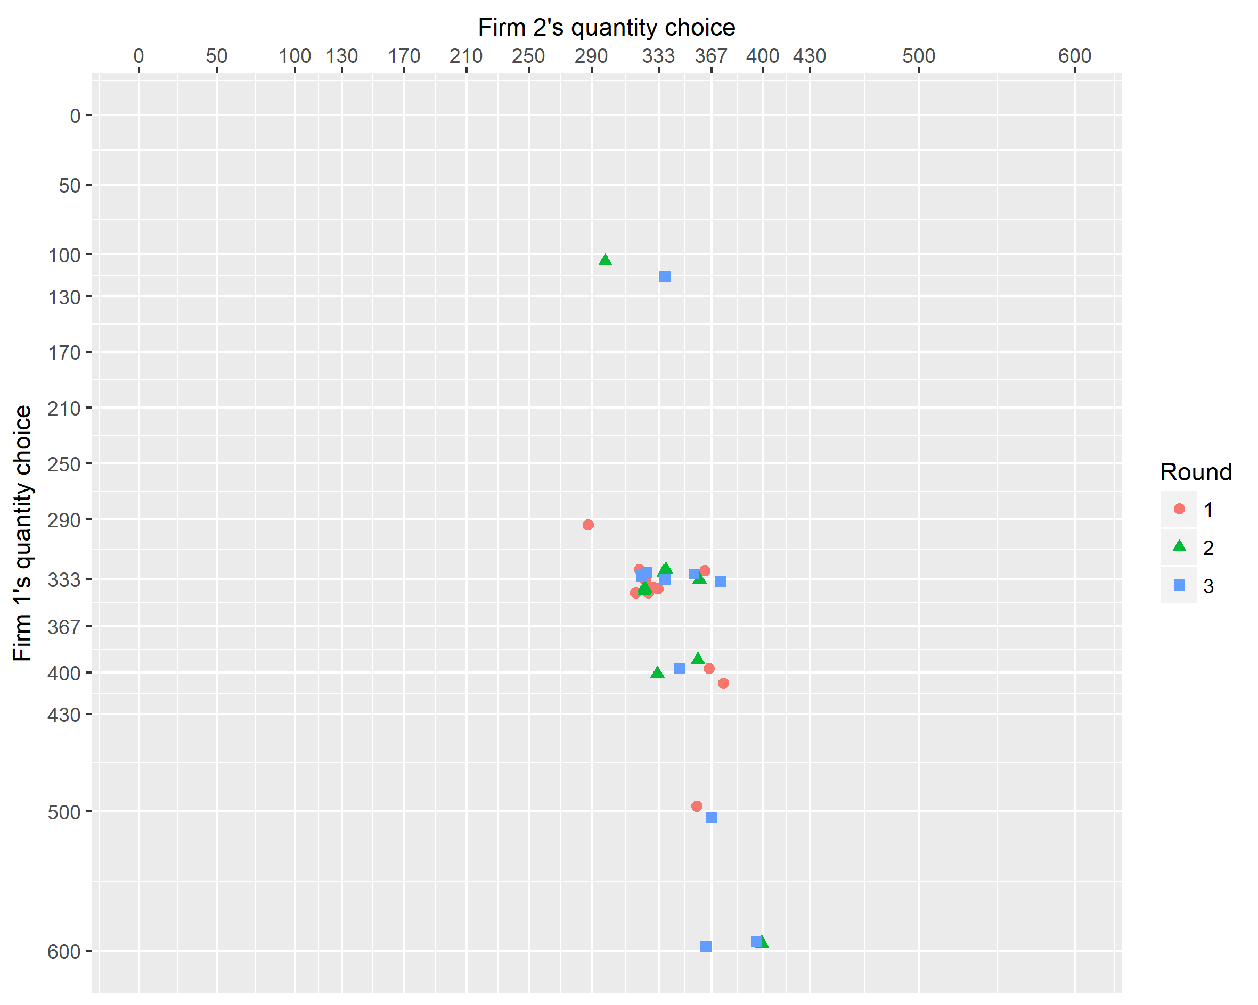
Experiment 6

Slide 11
Experiment 6
Many 1st movers switched between announcement and quantity choice, and so tried to “cheat” the second mover
But not always in the right direction?
→ Limited depth of reasoning?
1st movers should know that 2nd movers don’t trust their announcement
2nd movers should not react on the cheap talk announcement

