Slide 1
Experiment 2
Simultaneous price competition
a) Describe the incentives of each of the 5 companies in the souvenir market. In particular, take the perspective of one company. Then think about what the other companies could do, and what the best response of your company to each of the other companies’ potential actions would be. What is your best strategy?
b) What happens if the other companies are as clever as you are and also play your strategy?

Slide 2
Experiment 2
Players: 5 companies
Strategies:
Symmetric game
Each company can choose 0.30, 0.40, 0.60, 0.80, 1.00
Payoff for each company:
(P-0.26)*N
with N=600/x if P=lowest price=E$ 0.30,
480/x if P=lowest price=E$ 0.40,
360/x if P=lowest price=E$ 0.60,
240/x if P=lowest price=E$ 0.80,
120/x if P=lowest price=E$ 1.00,
0 otherwise.
and x = number of firms who set the lowest price

Slide 3
Experiment 2: Strategies
Player 2
Player 3?
Player 4?
Player 5?
 | 0.30 | 0.40 | 0.60 | 0.80 | 1.00
0.30
0.40
0.60
0.80
1.00
Player 1

Slide 4
Experiment 2: Strategies

Slide 5
Experiment 2: Strategies

Slide 6
Experiment 2: Strategies
Player 5: 0.30
Player 5: 0.40
Player 5: 0.60
Player 5: 0.80
Player 5: 1.00

Slide 7
Experiment 2: Simplification
Simplification: Players 2 - 5
 | 0.30 | 0.40 | 0.60 | 0.80 | 1.00
0.30
0.40
0.60
0.80
1.00
Player 1

Slide 8
Experiment 2: Payoffs
Players 2 - 5
 | 0.30 | 0.40 | 0.60 | 0.80 | 1.00
0.30 | 5 5 | 0 24 | 0 24 | 0 24 | 0 24
0.40 | 6 0 | 13 13 | 0 67 | 0 67 | 0 67
0.60 | 6 0 | 16 0 | 24.5 24.5 | 0 122 | 0 122
0.80 | 6 0 | 16 0 | 30 0 | 26 26 | 0 134
1.00 | 6 0 | 16 0 | 30 0 | 33 0 | 17 17
Player 1

Slide 9
Experiment 2: Best replies
Players 2 - 5
 | 0.30 | 0.40 | 0.60 | 0.80 | 1.00
0.30 | 5 5* | 0 24* | 0 24 | 0 24 | 0 24
0.40 | 6 0 | 13 13 | 0 67* | 0 67 | 0 67
0.60 | 6 0 | 16 0 | 24.5 24.5 | 0 122* | 0 122
0.80 | 6 0 | 16 0 | 30 0 | 26 26 | 0 134*
1.00 | 6 0 | 16 0 | 30 0 | 33 0 | 17 17
Player 1

Slide 10
Experiment 2: Best replies
Players 2 - 5
 | 0.30 | 0.40 | 0.60 | 0.80 | 1.00
0.30 | 5* 5 | 0 24 | 0 24 | 0 24 | 0 24
0.40 | 6 0 | 13* 13 | 0 67 | 0 67 | 0 67
0.60 | 6 0 | 16 0 | 24.5* 24.5 | 0 122 | 0 122
0.80 | 6 0 | 16 0 | 30* 0 | 26 26 | 0 134
1.00 | 6 0 | 16 0 | 30 0 | 33* 0 | 17 17
Player 1

Slide 11
Experiment 2: Best replies
Players 2 - 5
 | 0.30 | 0.40 | 0.60 | 0.80 | 1.00
0.30 | 5* 5* | 0 24* | 0 24 | 0 24 | 0 24
0.40 | 6 0 | 13* 13 | 0 67* | 0 67 | 0 67
0.60 | 6 0 | 16 0 | 24.5* 24.5 | 0 122* | 0 122
0.80 | 6 0 | 16 0 | 30* 0 | 26 26 | 0 134*
1.00 | 6 0 | 16 0 | 30 0 | 33* 0 | 17 17
Player 1

Slide 12
Experiment 2
So the Nash Equilibrium we found is:
Player 1 chooses price 0.30
Player 2 chooses price 0.30
Player 3 chooses price 0.30
Player 4 chooses price 0.30
Player 5 chooses price 0.30

Slide 13
Experiment 2: Best reply dynamics
Players 2 - 5
 | 0.30 | 0.40 | 0.60 | 0.80 | 1.00
0.30 | 5 5 | 0 24 | 0 24 | 0 24 | 0 24
0.40 | 6 0 | 13 13 | 0 67 | 0 67 | 0 67
0.60 | 6 0 | 16 0 | 24.5 24.5 | 0 122 | 0 122
0.80 | 6 0 | 16 0 | 30 0 | 26 26 | 0 134
1.00 | 6 0 | 16 0 | 30 0 | 33 0 | 17 17
Player 1

Slide 14
Experiment 2
Data
Analyze the data set. What can you tell about the behavior of market participants? Do participants behave as your analysis above suggests? Is there a change in behavior over time, in the different rounds of the markets?

Slide 15
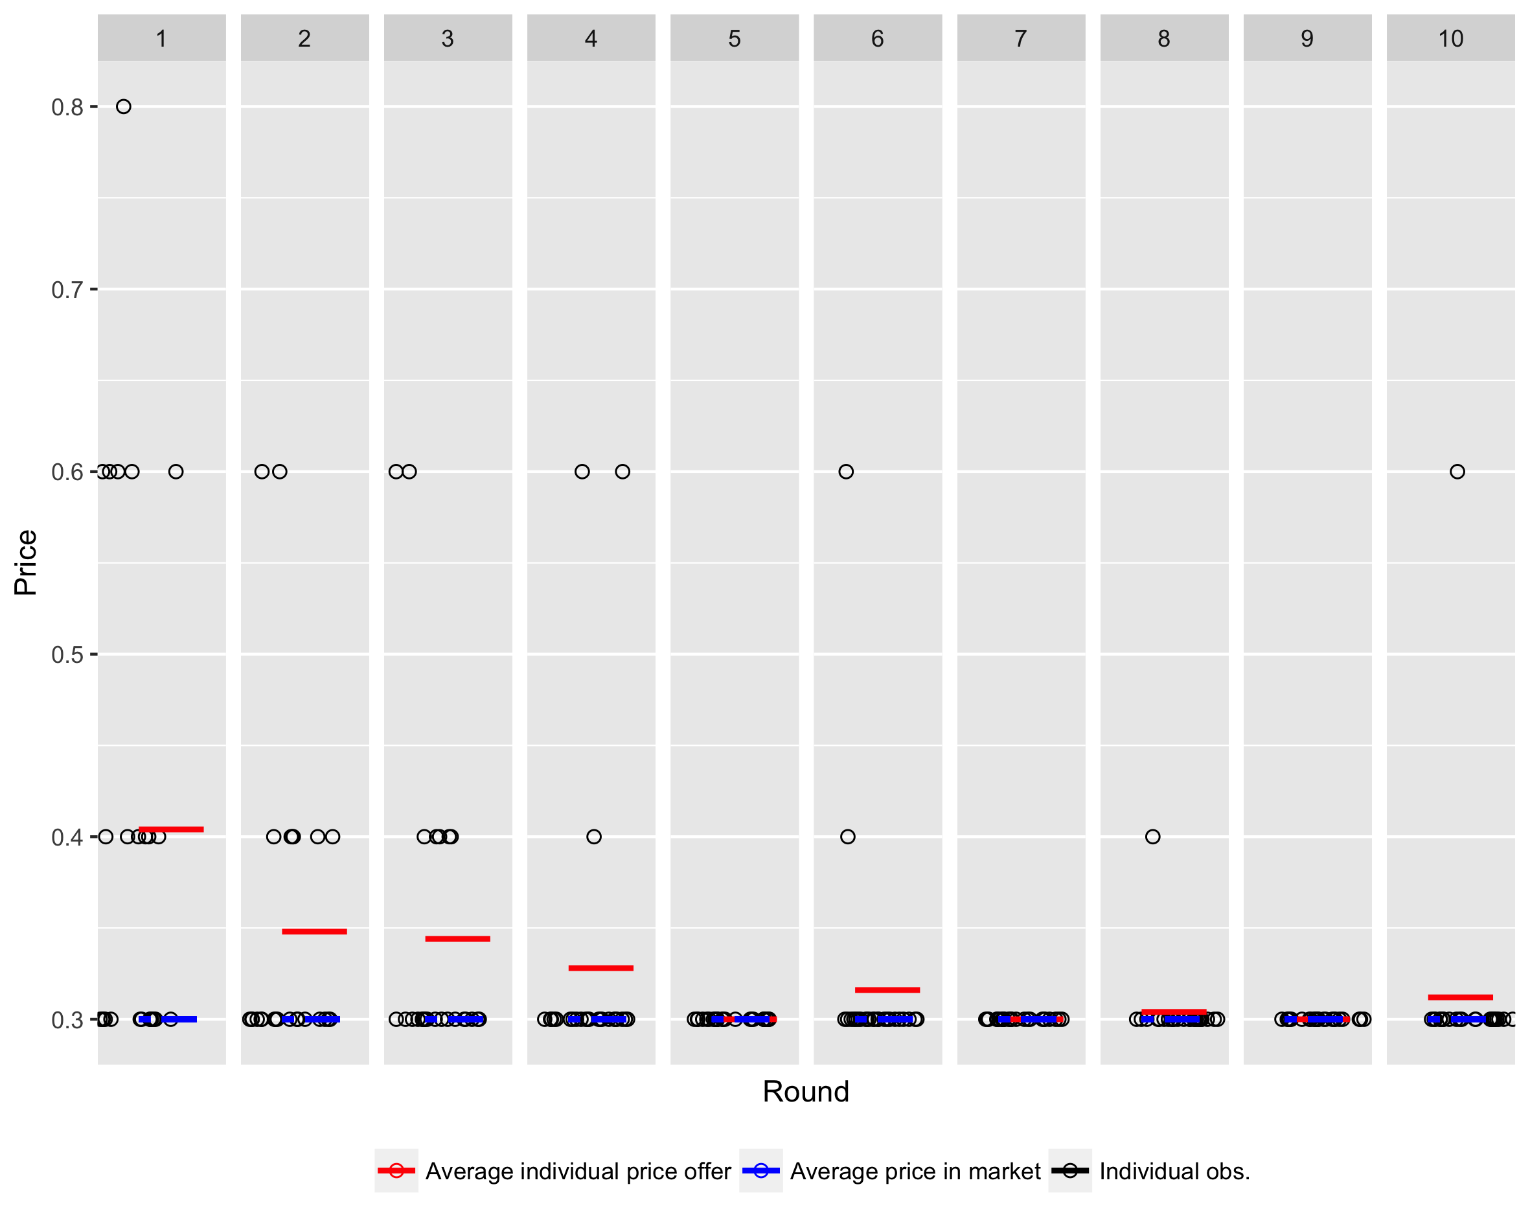
Experiment 2: Data

Slide 16
Experiment 2
Competition: One firm’s action (benefitting itself) does hurt another firm’s profit. E.g., if one firm lowers the price, the other firm loses profit, and vice versa. There are many possible levels/dimensions of competition.
Fierce price competition
Markets with very homogenous goods/close substitutes (if one firm raises its price, then people switch to the other firm)
Well-informed buyers with low search costs
→ highly elastic demand, change the price a bit and you lose all your customers
Free entry and exit into market: “threat of competition”
→ even monopolistic markets can have competitive prices

Slide 17
Experiment 2
Ways to “prevent” competition:
Basically, you want to change the game.
Illegal: Cartels (with punishment)
Legal:
Differentiation (products less homogenous)
Obfuscation (increase search costs, e.g. mobile contracts)
Other …

