Slide 1
Experiment 3
Sequential price competition
  Describe the incentives of each of the 5 companies in the market, depending on the order in which they play. In particular, take the perspective of the company which decides last, and think about its best strategy, depending on what the other companies did before. Then assume that the second-to-last company knows that the last company will behave this way, and think about the incentives of the second-to-last company. Continue with the companies deciding third, second, and first.
  What happens if all 5 companies apply the same way of thinking, so if all of them take into account the strategies their followers will play, and play a best reply to these and the behavior of their predecessors?

Slide 2
Experiment 3
Players: 5 companies
Payoffs: same as for Exp 2
Strategies:
  Company 1: 0.30, 0.40, 0.60, 0.80, 1.00
  Company 2:
  Strat1: If C1 0.30 then 0.30; if C1 0.40 then 0.30; if C1 0.60 then 0.30; if C1 0.80 then 0.30; if C1 1.00 then 0.30
  Strat2: If C1 0.30 then 0.30; if C1 0.40 then 0.30; if C1 0.60 then 0.30; if C1 0.80 then 0.30; if C1 1.00 then 0.40
  Strat3: If C1 0.30 then 0.30; if C1 0.40 then 0.30; if C1 0.60 then 0.30; if C1 0.80 then 0.40; if C1 1.00 then 0.40
  Strat4: If C1 0.30 then 0.30; if C1 0.40 then 0.30; if C1 0.60 then 0.40; if C1 0.80 then 0.40; if C1 1.00 then 0.40
  …

Slide 3
Experiment 3: Strategies
Players: 5 companies
Payoffs: same as for Exp 2
Strategies:
  Company 1: 0.30, 0.40, 0.60, 0.80, 1.00
  Company 2: 5⁵=3125 possible strategies, each strategy defines a response to all 5 possible actions by Comp 1
  Company 3: 5²⁵=2.98∙10¹⁷ possible strategies, each strategy defines a response for all 25 possible action-combinations by Companies 1 and Company 2
  Company 4: 5¹²⁵=2.35∙10⁸⁷ possible strategies, each strategy defines a response for all 125 possible action-combinations by Companies 1, 2, and 3
  Company 5: 5⁶²⁵=(~infinity) possible strategies, each strategy defines a response for all 625 possible action-combinations by Companies 1, 2, 3, and 4

Slide 4
Experiment 3: Strategies
Game has 3125 end nodes
1.00
0.80
4
0.60
0.40
0.30
1.00
0.80
5
0.60
0.40
0.30

Slide 5
Experiment 3 : Simplification
As before: simplify without losing details!
  Only lowest price set before counts for my decision
  Number of firms at this price important for my payoff
Thus,
for company 5, there are 17 possible outcomes of the decisions of companies 1 to 4
for company 4, there are 13 possible outcomes of the decisions of companies 1 to 3
for company 3, there are 9 possible outcomes of the decisions of companies 1 to 2

Slide 6
Experiment 3: Best replies
Then: Think from the end!
  Incentives for last firm given behavior before.
  Incentives for second last firm given behavior before and behavior to be expected from last firm
  Incentives for 3rd firm given behavior before and behavior to be expected from last 2 firms
  Incentives for 2nd firm given behavior of first firm and behavior to be expected from next 3 firms
  Incentives for first firm given behavior to be expected from next 4 firms

Slide 7
Experiment 3: Payoffs for last player
Lowest previous price | Number of firms with lp | 0.30 | 0.40 | 0.60 | 0.80 | 1.00
1.00 | 4 | 24 | 67 | 122 | 130 | 89
0.80 | 4 | 24 | 67 | 122 | 26 | 0
0.80 | 3 | 24 | 67 | 122 | 32 | 0
0.80 | 2 | 24 | 67 | 122 | 43 | 0
0.80 | 1 | 24 | 67 | 122 | 65 | 0
0.60 | 4 | 24 | 67 | 24.5 | 0 | 0
0.60 | 3 | 24 | 67 | 31 | 0 | 0
0.60 | 2 | 24 | 67 | 41 | 0 | 0
0.60 | 1 | 24 | 67 | 61 | 0 | 0
0.40 | 4 | 24 | 13 | 0 | 0 | 0
0.40 | 3 | 24 | 17 | 0 | 0 | 0
0.40 | 2 | 24 | 22 | 0 | 0 | 0
0.40 | 1 | 24 | 34 | 0 | 0 | 0
0.30 | 4 | 5 | 0 | 0 | 0 | 0
0.30 | 3 | 6 | 0 | 0 | 0 | 0
0.30 | 2 | 8 | 0 | 0 | 0 | 0
0.30 | 1 | 12 | 0 | 0 | 0 | 0

Slide 8
Experiment 3: Payoffs for 2nd last player
Lowest previous price | Number of firms with lp | 0.30 |  | 0.40 |  | 0.60 |  | 0.80 |  | 1.00
 |  | 5th will choose |  | 5th will choose |  | 5th will choose |  | 5th will choose |  | 5th will choose
1.00 | 3 | 0.3 | 12 | 0.4 | 34 | 0.4 | 0 | 0.6 | 0 | 0.8 | 0
0.80 | 3 | 0.3 | 12 | 0.4 | 34 | 0.4 | 0 | 0.6 | 0 | 0.6 | 0
0.80 | 2 | 0.3 | 12 | 0.4 | 34 | 0.4 | 0 | 0.6 | 0 | 0.6 | 0
0.80 | 1 | 0.3 | 12 | 0.4 | 34 | 0.4 | 0 | 0.6 | 0 | 0.6 | 0
0.60 | 3 | 0.3 | 12 | 0.4 | 34 | 0.4 | 0 | 0.4 | 0 | 0.4 | 0
0.60 | 2 | 0.3 | 12 | 0.4 | 34 | 0.4 | 0 | 0.4 | 0 | 0.4 | 0
0.60 | 1 | 0.3 | 12 | 0.4 | 34 | 0.4 | 0 | 0.4 | 0 | 0.4 | 0
0.40 | 3 | 0.3 | 12 | 0.3 | 0 | 0.3 | 0 | 0.3 | 0 | 0.3 | 0
0.40 | 2 | 0.3 | 12 | 0.3 | 0 | 0.3 | 0 | 0.3 | 0 | 0.3 | 0
0.40 | 1 | 0.3 | 12 | 0.3 | 0 | 0.4 | 0 | 0.4 | 0 | 0.4 | 0
0.30 | 3 | 0.3 | 5 | 0.3 | 0 | 0.3 | 0 | 0.3 | 0 | 0.3 | 0
0.30 | 2 | 0.3 | 6 | 0.3 | 0 | 0.3 | 0 | 0.3 | 0 | 0.3 | 0
0.30 | 1 | 0.3 | 8 | 0.3 | 0 | 0.3 | 0 | 0.3 | 0 | 0.3 | 0

Slide 9
Experiment 3: Payoffs for 3rd player
Lowest previous price | Number of firms with lp | 0.30 |  |  | 0.40 |  |  | 0.60 |  |  | 0.80 |  |  | 1.00
 |  | 4th | 5th |  | 4th | 5th |  | 4th | 5th |  | 4th | 5th |  | 4th | 5th
1.00 | 2 | 0.3 | 0.3 | 8 | 0.3 | 0.3 | 0 | 0.4 | 0.4 | 0 | 0.4 | 0.4 | 0 | 0.4 | 0.4 | 0
0.80 | 2 | 0.3 | 0.3 | 8 | 0.3 | 0.3 | 0 | 0.4 | 0.4 | 0 | 0.4 | 0.4 | 0 | 0.4 | 0.4 | 0
0.80 | 1 | 0.3 | 0.3 | 8 | 0.3 | 0.3 | 0 | 0.4 | 0.4 | 0 | 0.4 | 0.4 | 0 | 0.4 | 0.4 | 0
0.60 | 2 | 0.3 | 0.3 | 8 | 0.3 | 0.3 | 0 | 0.4 | 0.4 | 0 | 0.4 | 0.4 | 0 | 0.4 | 0.4 | 0
0.60 | 1 | 0.3 | 0.3 | 8 | 0.3 | 0.3 | 0 | 0.4 | 0.4 | 0 | 0.4 | 0.4 | 0 | 0.4 | 0.4 | 0
0.40 | 2 | 0.3 | 0.3 | 8 | 0.3 | 0.3 | 0 | 0.3 | 0.3 | 0 | 0.3 | 0.3 | 0 | 0.3 | 0.3 | 0
0.40 | 1 | 0.3 | 0.3 | 8 | 0.3 | 0.3 | 0 | 0.3 | 0.3 | 0 | 0.3 | 0.3 | 0 | 0.3 | 0.3 | 0
0.30 | 2 | 0.3 | 0.3 | 5 | 0.3 | 0.3 | 0 | 0.3 | 0.3 | 0 | 0.3 | 0.3 | 0 | 0.3 | 0.3 | 0
0.30 | 1 | 0.3 | 0.3 | 6 | 0.3 | 0.3 | 0 | 0.3 | 0.3 | 0 | 0.3 | 0.3 | 0 | 0.3 | 0.3 | 0

Slide 10
Experiment 3: Payoffs for 2nd player
Lowest previous price | Number of firms with lp | 0.30 |  |  |  | 0.40 |  |  |  | 0.60
 |  | 3rd | 4th | 5th |  | 3rd | 4th | 5th |  | 3rd | 4th | 5th
1.00 | 1 | 0.3 | 0.3 | 0.3 | 6 | 0.3 | 0.3 | 0.3 | 0 | 0.3 | 0.3 | 0.3 | 0
0.80 | 1 | 0.3 | 0.3 | 0.3 | 6 | 0.3 | 0.3 | 0.3 | 0 | 0.3 | 0.3 | 0.3 | 0
0.60 | 1 | 0.3 | 0.3 | 0.3 | 6 | 0.3 | 0.3 | 0.3 | 0 | 0.3 | 0.3 | 0.3 | 0
0.40 | 1 | 0.3 | 0.3 | 0.3 | 6 | 0.3 | 0.3 | 0.3 | 0 | 0.3 | 0.3 | 0.3 | 0
0.30 | 1 | 0.3 | 0.3 | 0.3 | 5 | 0.3 | 0.3 | 0.3 | 0 | 0.3 | 0.3 | 0.3 | 0
. . .
Lowest previous price | Number of firms with lp | 0.80 |  |  |  | 1.00
 |  | 3rd | 4th | 5th |  | 3rd | 4th | 5th
1.00 | 1 | 0.3 | 0.3 | 0.3 | 0 | 0.3 | 0.3 | 0.3 | 0
0.80 | 1 | 0.3 | 0.3 | 0.3 | 0 | 0.3 | 0.3 | 0.3 | 0
0.60 | 1 | 0.3 | 0.3 | 0.3 | 0 | 0.3 | 0.3 | 0.3 | 0
0.40 | 1 | 0.3 | 0.3 | 0.3 | 0 | 0.3 | 0.3 | 0.3 | 0
0.30 | 1 | 0.3 | 0.3 | 0.3 | 0 | 0.3 | 0.3 | 0.3 | 0
. . .

Slide 11
Experiment 3: Payoffs for 1st player
0.30 |  |  |  |  | 0.40 |  |  |  |  | 0.60
2nd | 3rd | 4th | 5th |  | 2nd | 3rd | 4th | 5th |  | 2nd | 3rd | 4th | 5th
0.3 | 0.3 | 0.3 | 0.3 | 5 | 0.3 | 0.3 | 0.3 | 0.3 | 0 | 0.3 | 0.3 | 0.3 | 0.3 | 0
0.80 |  |  |  |  | 1.00
2nd | 3rd | 4th | 5th |  | 2nd | 3rd | 4th | 5th
0.3 | 0.3 | 0.3 | 0.3 | 0 | 0.3 | 0.3 | 0.3 | 0.3 | 0

Slide 12
Experiment 3
So the (subgame perfect) Nash Equilibrium which we found by thinking from the end (“rollback”) is:
  1st player chooses price 0.30.
  2nd player chooses price 0.30 no matter what 1st player is doing.
  3rd player chooses price 0.30 no matter what 1st and 2nd player are doing.
  4th player chooses price 0.30 if previous lowest price is 0.30 or 0.40, and chooses price 0.40 otherwise.
  5th player chooses
    price 0.30 if previous lowest price is 0.30
    price 0.40 if previous lowest price is 0.40 chosen by 1 player,
    price 0.30 if prev. lowest price is 0.40 chosen by >1 players,
    price 0.40 if previous lowest price is 0.60,
    price 0.60 if previous lowest price is 0.80, and
    price 0.80 if previous lowest price is 1.00.

Slide 13
Experiment 3
Data
  Analyze the data set. What can you tell about the behavior of market participants? Do participants behave as your analysis above suggested? Is there a change in behavior over time, in the different rounds of the markets?

Slide 14
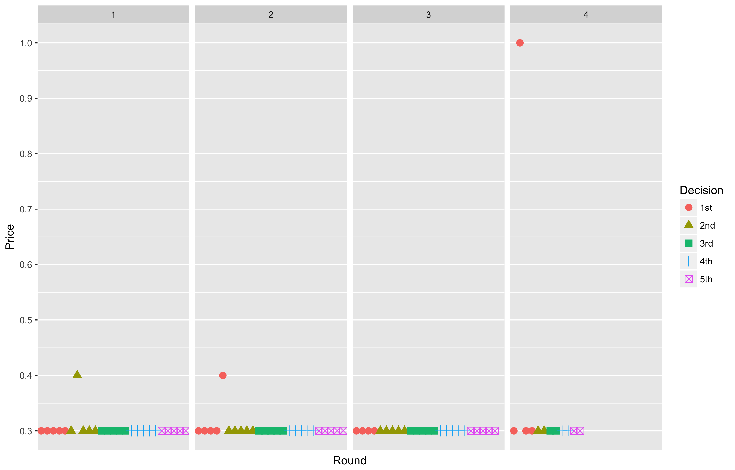
Experiment 3

