Slide 1
Experiment 13: Penalty kick
Analyze the role of pre-play communication in this game? What message should the Striker send? How should the Keeper react to that message?
Ignoring the message stage, derive all pure strategy Nash equilibria of the one-shot game.

Slide 2
Experiment 13: Penalty kick
 |  | Keeper
 |  | Left | Right
Striker | Left | 20 -20 | -20 20
 | Right | -20 20 | 20 -20
Pre-play communication?
If the choice of the Striker is correlated with his message (i.e. in any way dependent on it), then the Keeper always has a best reply, which is bad for the Striker.
Thus, the choice of the Striker should be uncorrelated to his message. As a result, pre-play communication is meaningless, „cheap talk”, and the Keeper should not react to it.
Nash equilibria?
There is no equilibrium in pure strategies: none of the four situations is stable, in each one player has an incentive to deviate.

Slide 3
Experiment 13: Penalty kick
Assume that the Striker could play a “randomized” strategy in which he chooses “Left” with probability P% and “Right” with probability 100%-P%.
Now, for the probabilities of P=30%, P=50%, and P=70%, check what the best answer(s) of the Keeper would be. Would in turn the Striker’s chosen P% also be the best answer to the Keeper’s best answer?
Do the same analysis for the “Keeper”, who might choose “Left” with probability Q% and “Right” with probability 100%-Q%.
Can you state a Nash equilibrium in which both players choose a P% and Q% such that their “randomized” strategies are best answers to each other?

Slide 4
Experiment 13: Penalty kick
 |  | Keeper
 |  | Left | Right
Striker | Left | 20 -20 | -20 20
 | Right | -20 20 | 20 -20
Both players have the possibility to choose a strategy which chooses randomly from the available pure strategies given some probability distribution.
In Nash equilibrium, beliefs are right.
Thus, we are looking for a situation where each chooses a strategy where he cannot do better given the other‘s strategy, but still the other correctly expects this strategy.

Slide 5
Experiment 13: Penalty kick
In a mixed strategy, a player chooses a probability distribution over his pure strategies.
 |  | Keeper
 |  | Left | Right
Striker | Left | 20 -20 | -20 20
 | Right | -20 20 | 20 -20
q
1-q
p
1-p
Now, say Striker plays a mixed strategy p to which the Keeper prefers to dive Left rather than Right. Then, the Striker will expect him to dive Left, so the Striker’s best answer is just to shoot right and not mix.
Thus, the only stable situation in this game is where the Keeper is indifferent between Left and Right, given the Striker’s mixed strategy. Vice versa, the Striker needs to be indifferent with respect to the Keeper’s strategy in a stable mixed strategy situation.
In other words: each player wants to keep the other player guessing about his action.

Slide 6
Experiment 13: Penalty kick
 |  | Keeper
 |  | Left | Right
Striker | Left | 20 -20 | -20 20
 | Right | -20 20 | 20 -20
Keeper’s best response function to Striker’s p choice
Striker’s best response function to Keeper’s q choice
q
1-q
p
1-p
Keeper’s q
1
Left
The only situation where both play best response is where the best reply functions intersect: at p=q=0.5
In math:
p*20+(1-p)*-20 = p*-20+(1-p)*20
20p-20+20p=-20p+20-20p |+20+40p
80p=40 → p=0.5
0.5
Right
0
Right
0.5
1
Left
Striker’s p

Slide 7
Experiment 13: Penalty kick
Data
Analyze the data set of this experiment. Specifically, look at how individual participants play over the rounds. How does that relate to the results from your analysis under c)?

Slide 8
Experiment 13: Penalty kick
% message
left correct
85% 65%
81% 52%
56% 52%
63% 52%
63% 56%
 |  | Keeper
 |  | Left 74% | Right 26%
Striker | Left 63% | -20, 20 | 20, -20
 | Right 37% | 20, -20 | -20, 20
Round 1
 |  | Keeper
 |  | Left 52% | Right 48%
Striker | Left 48% | -20, 20 | 20, -20
 | Right 52% | 20, -20 | -20, 20
Round 2
 |  | Keeper
 |  | Left 44% | Right 56%
Striker | Left 44% | -20, 20 | 20, -20
 | Right 56% | 20, -20 | -20, 20
Round 3
 |  | Keeper
 |  | Left 37% | Right 63%
Striker | Left 44% | -20, 20 | 20, -20
 | Right 56% | 20, -20 | -20, 20
Round 4
 |  | Keeper
 |  | Left 52% | Right 48%
Striker | Left 48% | -20, 20 | 20, -20
 | Right 52% | 20, -20 | -20, 20
Round 5

Slide 9
Experiment 13: Penalty kick
P ID | As Striker | As Keeper | Mess. as Str.
1 | 1:0 | 2:2 | 0:1
2 | 0:1 | 3:1 | 0:1
3 | 1:2 | 2:0 | 1:2
4 | 2:2 | 1:0 | 2:2
5 | 1:1 | 2:1 | 1:1
6 | 2:0 | 0:3 | 2:0
7 | 2:1 | 1:1 | 3:0
8 | 1:1 | 0:3 | 1:1
9 | 0:3 | 2:0 | 3:0
10 | 1:2 | 2:0 | 2:1
11 | 0:0 | 2:3 | 0:0
12 | 0:3 | 1:1 | 3:0
13 | 2:0 | 1:2 | 2:0
14 | 0:3 | 1:1 | 3:0
15 | 0:0 | 2:3 | 0:0
16 | 1:3 | 0:1 | 3:1
17 | 1:2 | 1:1 | 2:1
18 | 1:2 | 1:1 | 3:0
19 | 2:0 | 3:0 | 1:1
20 | 0:2 | 1:2 | 1:1
21 | 2:2 | 1:0 | 3:1
22 | 1:0 | 2:2 | 1:0
23 | 1:4 | 0:0 | 2:3
24 | 0:2 | 2:1 | 0:2
25 | 4:0 | 1:0 | 4:0
26 | 2:1 | 1:1 | 2:1
27 | 0:1 | 0:4 | 1:0
28 | 3:0 | 1:1 | 1:2
29 | 2:1 | 1:1 | 2:1
30 | 2:1 | 0:2 | 3:0
P ID | As Striker | As Keeper | Mess. as Str.
1 | 0:2 | 1:2 | 1:1
2 | 1:1 | 3:0 | 2:0
3 | 1:2 | 1:1 | 3:0
4 | 0:2 | 1:2 | 2:0
5 | 1:1 | 3:0 | 2:0
6 | 2:0 | 2:1 | 1:1
7 | 1:1 | 2:1 | 2:0
8 | 3:0 | 0:2 | 2:1
9 | 5:0 | 0:0 | 4:1
10 | 0:2 | 2:1 | 1:1
11 | 1:1 | 1:2 | 0:2
12 | 2:1 | 0:2 | 2:1
13 | 2:0 | 3:0 | 2:0
14 | 2:2 | 1:0 | 3:1
15 | 1:1 | 1:2 | 1:1
16 | 1:2 | 1:1 | 2:1
17 | 1:1 | 1:2 | 2:0
18 | 1:1 | 2:1 | 2:0
19 | 2:0 | 3:0 | 2:0
20 | 0:3 | 1:1 | 3:0
21 | 2:2 | 0:1 | 1:3
22 | 1:1 | 1:2 | 1:1
23 | 2:1 | 0:2 | 1:2
24 | 0:1 | 3:1 | 0:1
Individual behavior over rounds
left:right
Participants seem to randomize (only 3 rounds observed ☹):
83% switch at least once within a role
72% sent the wrong message at least once as Striker

Slide 10
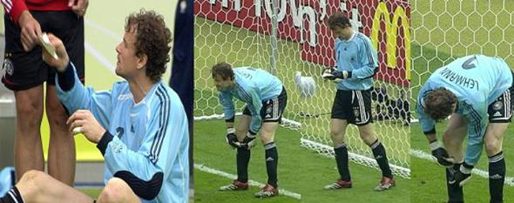
WC 2006 Quarter finals: GER – ARG
1:1 after regular time → Penalty shootout
Keeper coach Andi Köpke gives Keeper Jens Lehmann a cheat sheet
Notes:
n.V= nahc Verlängerung dann
11 meter schießén
Warum könnte er das Machen?

Slide 11
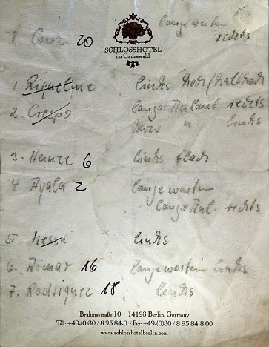
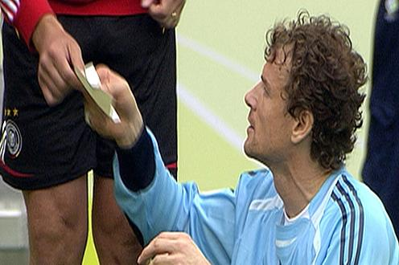
WC 2006 Quarter finals: GER – ARG
1:1 after regular time → Penalty shootout
If people randomize, why would Lehman need a cheat sheet?
Real people have a hard time to randomize ...
Use a random device!
Airport
Notes:
Warum hat er einen Zettel bekommen: Weil viele nicht zufälölig sind: was menschen öfter machen

Slide 12
Mixed strategies
Mixed strategy: player chooses a probability distribution over his pure strategies.
→ plays each of his pure strategies with a certain probability.
Mixed strategy Nash equilibrium:
combination of all players’ probability distributions over pure strategies
such that no player has an incentive to play a different probability distribution.

Slide 13
Mixed strategies
Necessary condition to play a mixed strategy:
players must be indifferent between their pure strategies (which they play with positive probability)
because if one pure strategy is better than others, they would choose that pure strategy with 100% and not mix.
Thus, in a (purely) mixed-strategy Nash equilibrium,
each player chooses a mixed strategy such that the other player is indifferent which pure strategy to choose,
and therefore will play a mixed strategy, too.
Thus, this is how we solve for a mixed strategy equilibrium:
For each player we are looking for the mixed strategy which sets the other players indifferent between their pure strategies.

Slide 14
Experiment 12: Market Entry Game
 |  | E2
 |  | Enter | Not enter
E1 | Enter | -50 -20 | 0 40
 | Not enter | 10 0 | 0 0
2 pure strategy Nash equilibria
Enter, Not enter
Not enter, Enter
But there is also a mixed-strategy equilibrium.
Now assume than one player enters with probability p, and the other player enters with probability q.
For which p and q is this an equilibrium?
When I play a mixed strategy, and she prefers one over the other, then she will purely play the one she prefers, which also brings us back to our pure strategy best response. Thus, we have to set her indifferent. This applies to both players.
q
1-q
p
1-p

Slide 15
Experiment 12: Market Entry Game
 |  | E2
 |  | Enter | Not enter
E1 | Enter | -50 -20 | 0 40
 | Not enter | 10 0 | 0 0
2 pure strategy Nash equilibria
Enter, Not enter
Not enter, Enter
+ 1 mixed equilibrium
E2 is indifferent if p*-50 + (1-p)*10 = p*0 + (1-p)*0
→ -50p+10-10p=0 → 10 = 60p → p=1/6
E1 is indifferent if q*-20 + (1-q)*40 = q*0 + (1-q)*0
→ -20q+40-40q=0 → 40 = 60q → q=4/6
In the mixed strategy Nash equilibrium,
E1 enters with probability 17% and stays out with probability 83%,
E2 enters with probability 66% and stays out with probability 33%.
The “weaker” player plays more aggressively.
q
1-q
p
1-p

Slide 16
Experiment 12: Market Entry Game
E2’s best response function to E1’s p choice
E1’s best response function to E2’s q choice
 |  | E2
 |  | Enter | Not enter
E1 | Enter | -50 -20 | 0 40
 | Not enter | 10 0 | 0 0
q
1-q
p
E2’s q
1-p
1
Enter
There are three equilibria:
p=0, q=1
p=1, q=0
p=1/6, q=4/6
0.5
Not enter
0
Not enter
0.5
Enter
1
E1’s p

Slide 17
Scissors, Paper, Rock
Example:
2 player Scissors, Paper, Rock game:
What is the equilibrium?
Player 1 Player 2
Scissors-Scissors 0 0
Scissors-Paper 1 -1
Scissors-Rock -1 1
Paper-Scissors -1 1
Paper-Paper 0 0
Paper-Rock 1 -1
Rock-Scissors 1 -1
Rock-Paper -1 1
Rock-Rock 0 0
1
2
3

Slide 18
Scissors, Paper, Rock
Example:
2 player Scissors, Paper, Rock game:
What is the equilibrium?
Bart & Lisa
 | Rock | Paper | Scissors
Rock | 0 0 | 1 -1 | -1 1
Paper | -1 1 | 0 0 | 1 -1
Scissors | 1 -1 | -1 1 | 0 0

Slide 19
Scissors, Paper, Rock
Example:
2 player Scissors, Paper, Rock game:
What is the equilibrium?
Bart & Lisa
Mixed Equilibrium:
p*0+q*-1+(1-p-q)*1 = p*1 + q*0 + (1-p-q)*-1 = p*-1 + q*1 + (1-p-q)*0
-2q+1-p = 2p -1+q = -p + q
2p -1+q = -p + q → 3p =1 → p=1/3
-2q+1-p = -p + q→ -3q = -1 → q=1/3 → (1-p-q)=1/3
→ A game of pure luck: play randomly Rock, Paper, Scissors …
 | Rock | Paper | Scissors
Rock | 0 0 | 1 -1 | -1 1
Paper | -1 1 | 0 0 | 1 -1
Scissors | 1 -1 | -1 1 | 0 0
p
q
1-p-q

