Slide 1
Experiment 4
Monopoly
  What kind of experiment is this: sequential or simultaneous? What is the best approach to solve the game?
  Determine the optimal strategy of each buyer, and the optimal strategy of the seller. Take into account the order of play. Assume that if a buyer is indifferent between buying or not buying (i.e. he makes the same profit in either case), he would buy.
  Is what you found a Nash equilibrium? Is it the only Nash equilibrium?

Slide 2
Experiment 4
Monopoly: only one seller, can set the price alone
Sequential game: monopolist moves first, buyers follow
Solve backwards:
  What will buyers do depending on price?
  Which price will monopolist set?

Slide 3
Experiment 4
Extensive Form
100
200
Subgame 2
Subgame 1
Quantity (Price, Value)
S
Price
B_{v}
0
0
Solve backwards
What will buyers do depending on price and their value?
Given this: which price will the monopolist set given the optimal strategies and values of the buyers?

Slide 4
Experiment 4
Buyers should buy if they make profit by buying from the monopolist and selling to their customers
In particular:
  Buyer 1 should buy 200 if price < E$4, is indifferent if price = E$4, and should not buy if price > E$4
  Buyer 2 should buy 200 if price < E$14, is indifferent if price = E$14, and should not buy if price > E$14
  Buyer 3 should buy 200 if price < E$34, is indifferent if price = E$34, and should not buy if price > E$34
  Buyer 4 should buy 200 if price < E$54, is indifferent if price = E$54, and should not buy if price > E$54
  Buyer 5 should buy 200 if price < E$74, is indifferent if price = E$74, and should not buy if price > E$74

Slide 5
Experiment 4
What prospects does the monopolist have?
Assume buyers do buy if indifferent. Then:
  If he sets a price≤ E$ 4, he will sell 1000 bottles.
  If he sets a price ≤ E$14, he will sell 800 bottles.
  If he sets a price ≤ E$34, he will sell 600 bottles.
  If he sets a price ≤ E$54, he will sell 400 bottles.
  If he sets a price ≤ E$74, he will sell 200 bottles.
Thus, profits are
  P=E$ 4 → Π=$E 4 * 1000 = E$ 4000
  P=E$ 14 → Π=$E14 * 800 = E$ 11200
  P=E$ 34 → Π=$E34 * 600 = E$ 20400
  P=E$ 54 → Π=$E54 * 400 = E$ 21600
  P=E$ 74 → Π=$E74 * 200 = E$ 14800

Slide 6
Experiment 4
So the (subgame perfect) Nash equilibrium which we found by rollback is:
  Buyer 1: buy if p<=4, don’t buy if p>4
  Buyer 2: buy if p<=14, don’t buy if p>14
  Buyer 3: buy if p<=34, don’t buy if p>34
  Buyer 4: buy if p<=54, don’t buy if p>54
  Buyer 5: buy if p<=74, don’t buy if p>74
  Seller: offer price of 54
Remember: When stating the NE, we name each player’s equilibrium strategy.

Slide 7
Experiment 4
Compare to competition experiments:
  Add E$26 constant variable costs to all prices, divide all by 100 → costs 0.26, prices 0.30, 0.40, 0.60, 0.80, 1.00
  Multiply demand with 0.6, and you get 120, 240, 360, 480, 600.
→ That’s our experiment 2 from last lecture!!!
Only that in experiment 2, 5 firms were interacting in the market, simultaneously announcing prices and trying to undercut each other, while here they are all “aggregated” to one firm, which makes one single decision.
Price in competition: E$ 0.30 (= $E 4 here in experiment 4)
Monopoly price: E$ 0.80 (= $E 54 here in experiment 4)
The monopoly price is the price at which firms would coordinate if they could effectively collude.

Slide 8
Experiment 4
This is the only subgame perfect equilibrium in this game. But that there are many other Nash equilibria.
Assume, for example, the following strategies:
  Buyer 1: buy if p<=4, don’t buy if p>4
  Buyer 2: buy if p<=4, don’t buy if p>4
  Buyer 3: buy if p<=4, don’t buy if p>4
  Buyer 4: buy if p<=4, don’t buy if p>4
  Buyer 5: buy if p<=4, don’t buy if p>4
  Seller: offer price of 4
The best response of the monopolist is to offer a price of E$4. To the offer of $E4, the buyers’ strategies described above is one of the best responses.
So we have a Nash equilibrium.

Slide 9
Experiment 4
  Buyer 1: buy if p<=4, don’t buy if p>4
  Buyer 2: buy if p<=4, don’t buy if p>4
  Buyer 3: buy if p<=4, don’t buy if p>4
  Buyer 4: buy if p<=4, don’t buy if p>4
  Buyer 5: buy if p<=4, don’t buy if p>4
  Seller: offer price of 4
But:
  The threat of buyers 2, 3, 4 and 5 to only buy at $4 is not credible if they are selfish and rational. If they were offered a higher price > $E 4, some of them would still buy.
  Thus, the monopolist should not believe the threat. This Nash Equilibrium is not subgame perfect.

Slide 10
Experiment 4
Data
  Analyze the data set. What can you tell about the behavior of buyers and seller? Do they behave as your analysis above suggested? Is there a change in behavior over time, in the different rounds of the market?

Slide 11
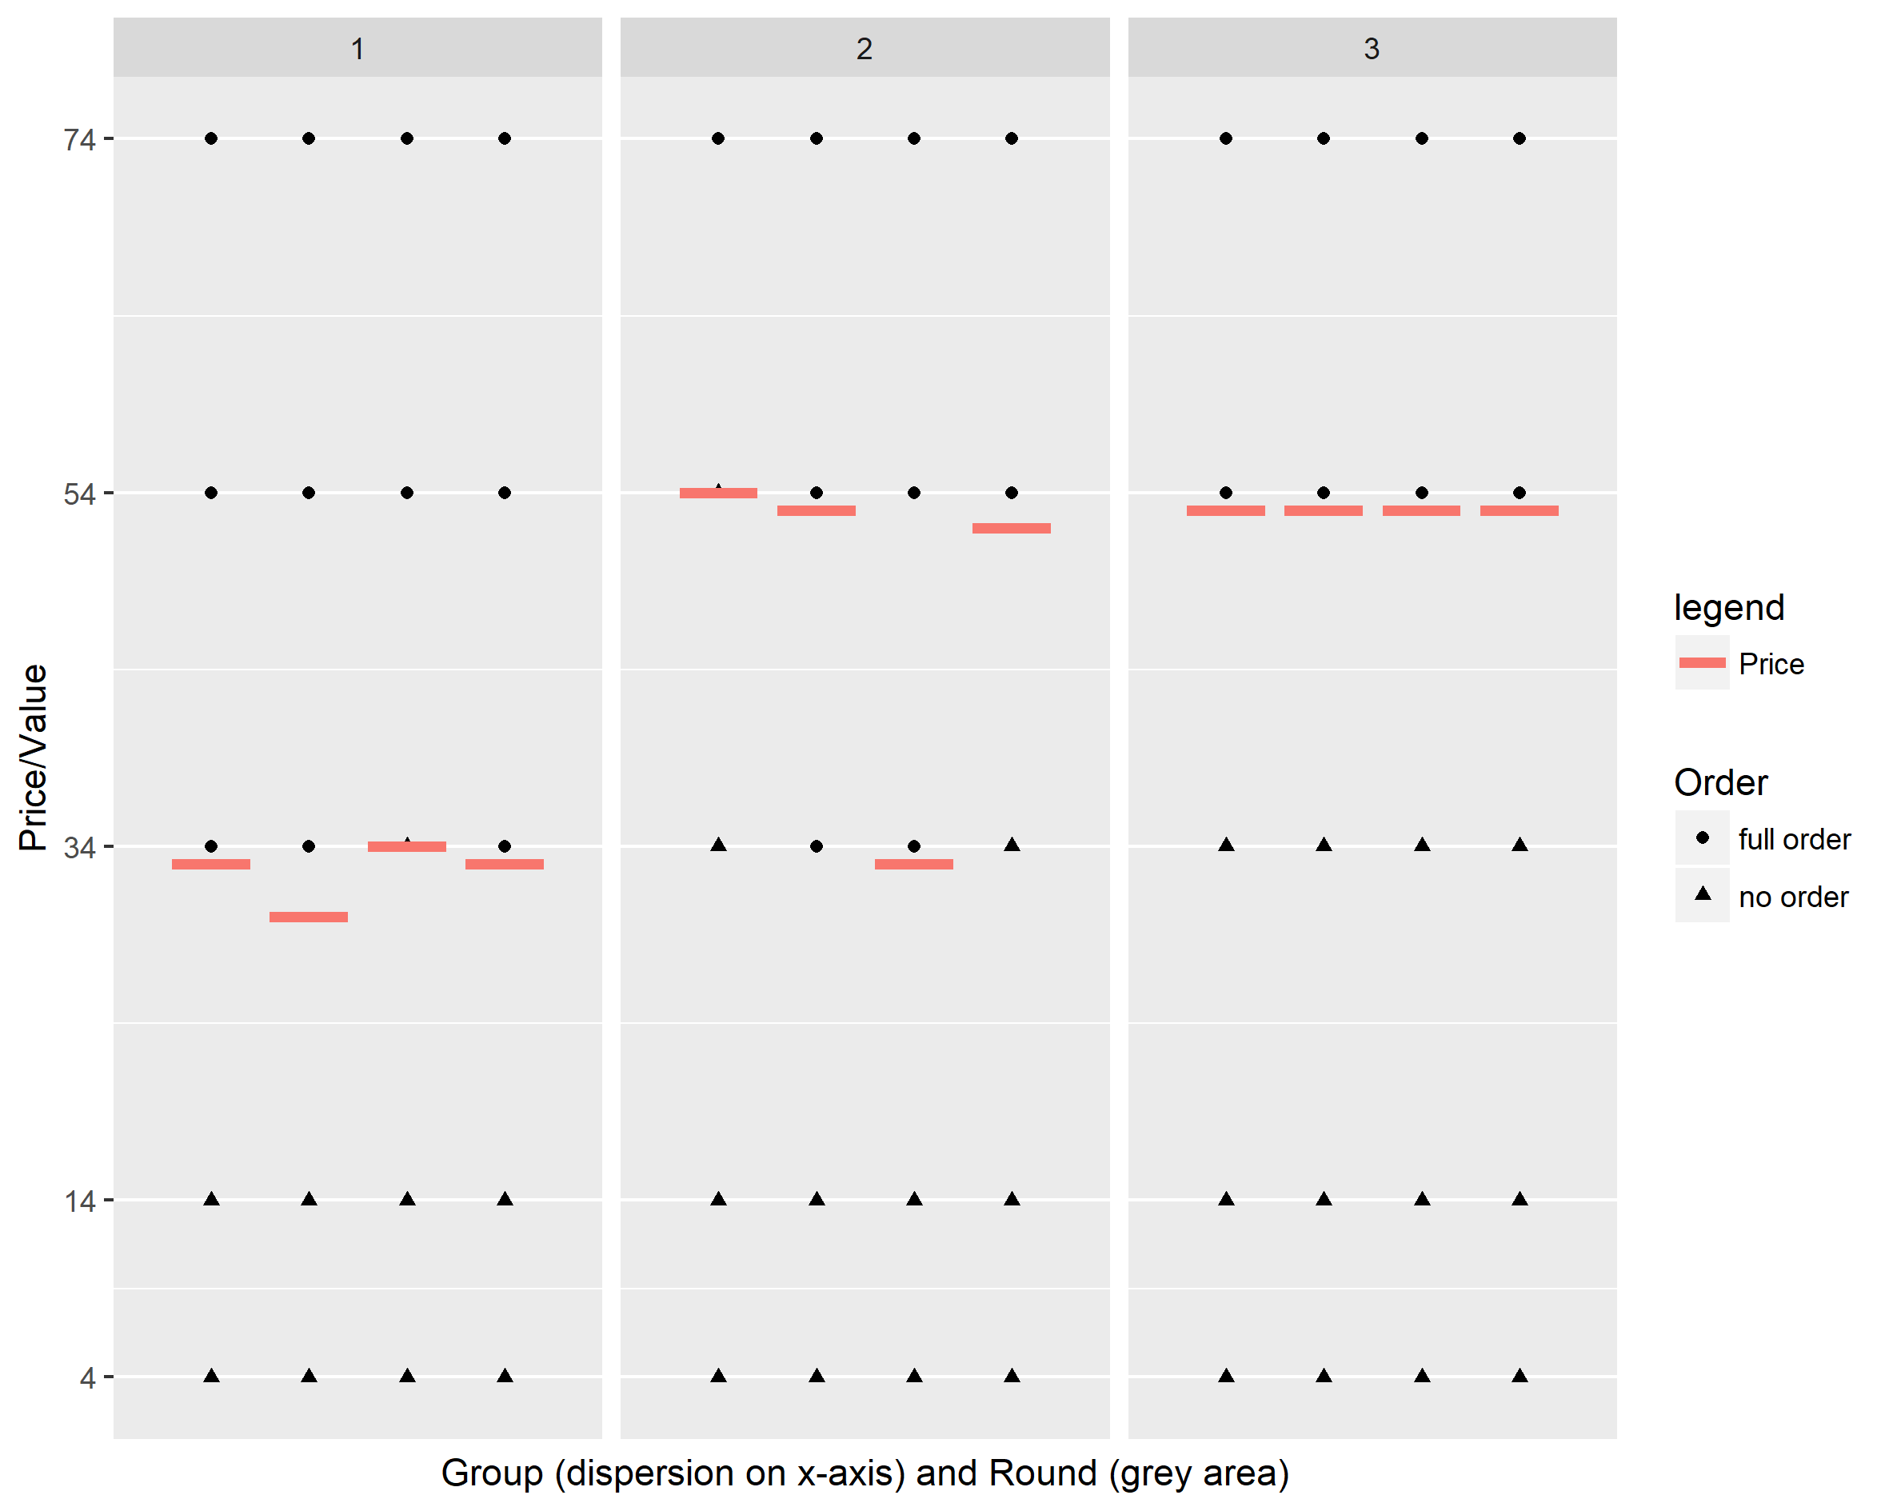
Experiment 4
Avg Price: 32.5 48.0 53.0

Slide 12
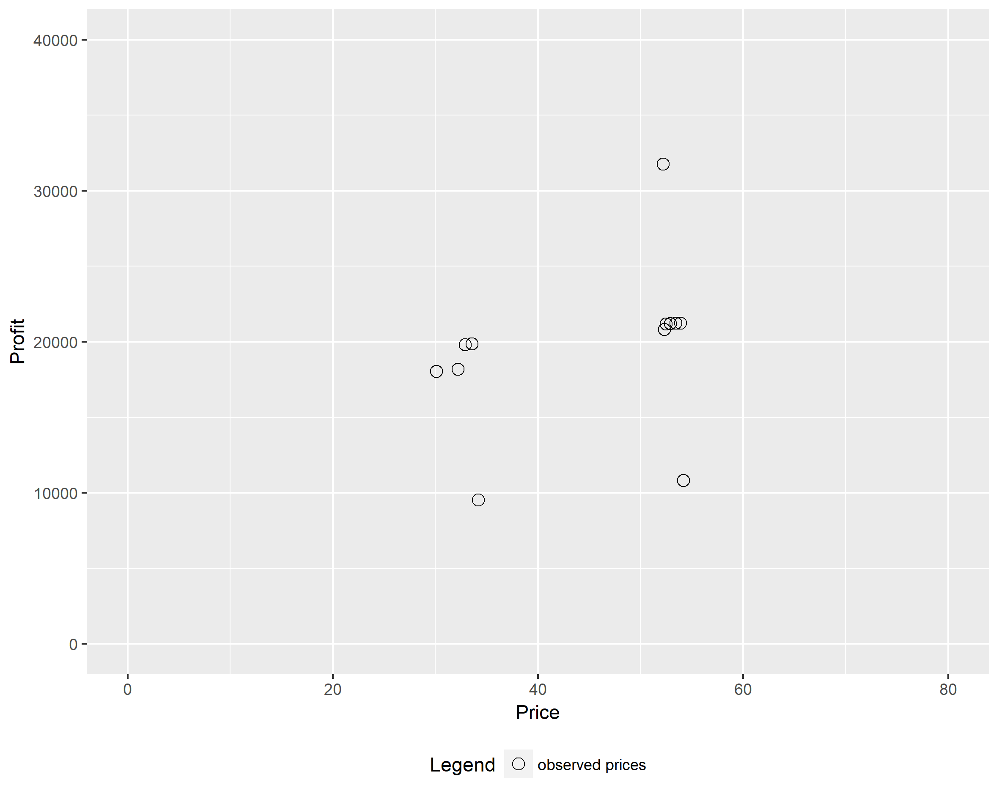
Experiment 4

Slide 13
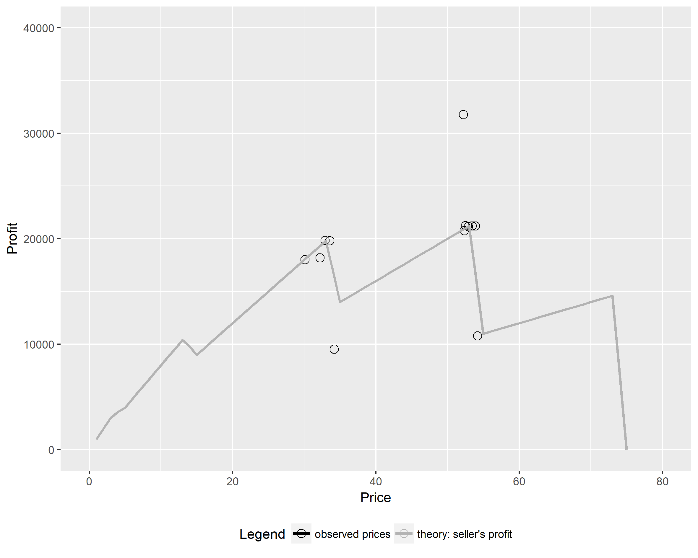
Experiment 4

Slide 14
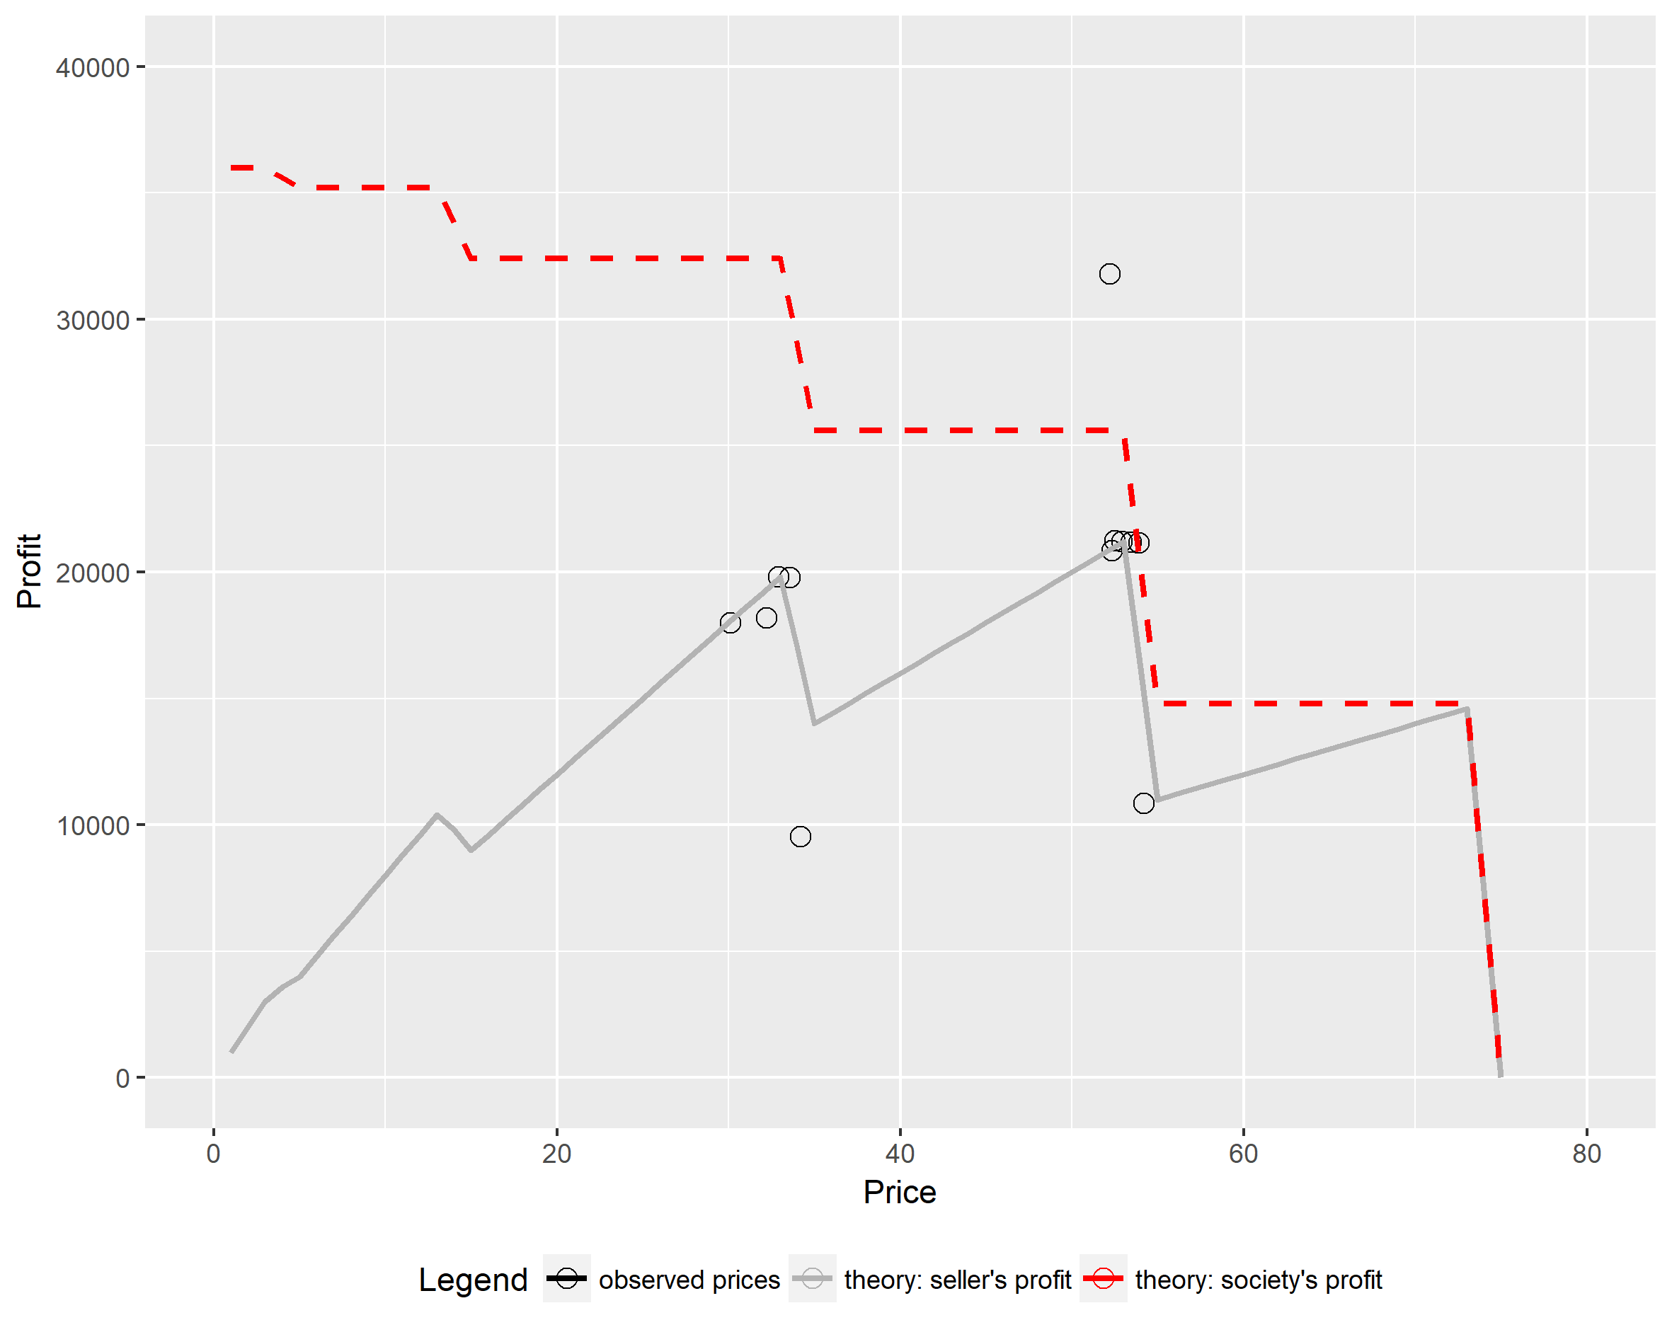
Experiment 4
Society’s profit = sum of seller’s and buyer’s profit
Welfare/
efficiency loss due to monopoly

