Slide 1
Experiment 15: Minimum Game
  Derive all Nash equilibria of the one-shot version of this simultaneous game, assuming that all players are rational and that payoffs represent utility. (As it is difficult to write down a Normal form game for 6 players, argue logically: In which situations does no player have an incentive to deviate, given what the other players are doing?)
  How do the equilibria differ from each other? Pick two equilibria and present arguments why the players would coordinate on one or the other?

Slide 2
Experiment 15: Minimum Game
 |  | Smallest Value of X Chosen in the Group
 |  | 1 | 2 | 3 | 4 | 5 | 6 | 7
 | 1 | E$8.00
Your | 2 | E$4.00 | E$14.40
Choice | 3 | E$2.00 | E$7.20 | E$17.60
of | 4 | E$1.00 | E$3.60 | E$8.80 | E$19.20
X | 5 | E$0.50 | E$1.80 | E$4.40 | E$9.60 | E$20.00
 | 6 | E$0.25 | E$0.90 | E$2.20 | E$4.80 | E$10.00 | E$20.40
 | 7 | E$0.13 | E$0.45 | E$1.10 | E$2.40 | E$5.00 | E$10.20 | E$20.60
All strategy combinations where all players choose the same are an Nash equilibrium. Thus, we have 7 NE.
The equilibrium “all choose 7” yields the highest payoffs for all. However, when you go for 7, any deviation by another player reduces your payoff dramatically.
The equilibrium “all choose 1” is the safest. If you go for 1, you earn $8 for sure. It also guarantees you the “highest minimum payoff” (maximin) → coordination problems

Slide 3
Experiment 15: Minimum Game
Question: How do people coordinate on a specific equilibrium if there are multiple equilibria, if no communication is allowed? In game theory, this is called the problem of equilibrium selection.
→ refinements: which of many Nash equilibria are “more rational”?
  Subgame perfection / sequential equilibria
  Trembling hand perfection, evolutionary stability
→ equilibrium selection: which of many “rational” Nash equilibria should we choose?
  Payoff dominance
  Risk dominance

Slide 4
Experiment 15: Minimum Game
  Describe a real-world example for this game, i.e. a situation in real life/business in which the incentives and problems are similar to this game?

Slide 5
Experiment 15: Minimum Game
Real world example (Do you know more?):
Imagine an airline crew which has to prepare an airplane for take-off, and each team member receives a bonus based on take-off time:
  the pilots prepare the cockpit and check the instruments
  the flight attendants clean the cabin, others check in the passengers
  the skycaps fill the luggage into the cargo space
  technicians make some checks of all equipment
  the security guy checks that ominous passenger
The airplane can only take off after all of these people have finished their jobs. That means the slowest person in the team determines the success of all team members.
Nobody wants to invest more effort than the slowest member, as that would be wasted effort.

Slide 6
Experiment 15: Minimum Game
Data
  Analyze the data set of experiment 15. Do participants play equilibrium strategies? On which equilibria do they coordinate? Is there a change over the rounds?

Slide 7
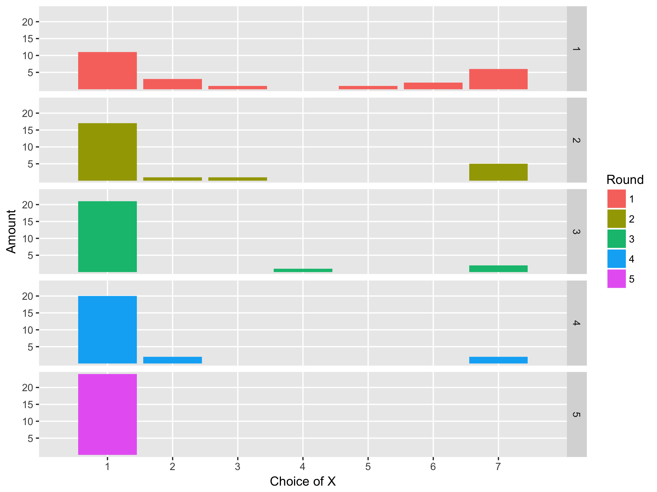
Experiment 15: Minimum Game
“all choose 1” and
“all choose 7”
most prominent equilibrium strategies in first round
Strong convergence towards “all choose 1” over rounds

