Slide 1
Experiment 14
Dilemma of unknown (probabilistic) length
Write down this game as exact and concise as you can. Derive at least one subgame perfect Nash equilibrium of this game. Show that the equilibrium you found is indeed subgame perfect.
Can cooperation be achieved in this game by rational, egoistic players? How could they reach it?

Slide 2
Experiment 14
Dilemma of unknown (probabilistic) length
Backward induction?
→ No defined end, so no rollback possible!
→ Any round is equal, as the expected number of rounds to play stays the same in each round.
What now?
Player 2
 | 0.08 | 0.12
0.08 | 12* 12* | 0 24*
0.12 | 24* 0 | 17.5 17.5
Player 1
Is 0.08/0.08, played in all rounds, still an equilibrium?
Yes. But there are more!
δ=0.9

Slide 3
Experiment 14
Player 2
 | 0.08 | 0.12
0.08 | 12* 12* | 0 24*
0.12 | 24* 0 | 17.5 17.5
Player 1
Assume players choose the following strategies:
Player 1: I choose a low price all the time.
Player 2: I choose a low price all the time.
This is a Nash equilibrium. Given the strategy of the other guy, I have no incentive to ever deviate from this.

Slide 4
Experiment 14
What is a subgame in this game?
Remember: a subgame is a game which starts at some decision node after the root node of the original game.
In an infinite game with a fixed discount factor/continuation probability per repetition, the same game is repeated again and again.
Thus, a subgame of the infinitely repeated game is the same infinitely repeated game as the original game.
Ergo, an equilibrium found for the original game, the infinitely repeated game starting today, must be also an equilibrium in each subgame starting later, and can therefore be called subgame perfect.

Slide 5
Experiment 14
Player 2
Assume the following grim trigger strategies: “I start with cooperating. If you cooperate, then I will continue cooperating. If you defect once, from the next round on I will defect forever.”
 | 0.08 | 0.12
0.08 | 12* 12* | 0 24*
0.12 | 24* 0 | 17.5 17.5
Player 1
Is playing these strategies an equilibrium?
Say I comply with the strategy, then my expected profit is:
If I deviate once, and then always have no cooperation:
Is the punishment credible? Yes: It’s the one-shot Nash!!!

Slide 6
Experiment 14
Data
Analyze the data set of experiment 14. Do you see any pattern in the interactions of the two players?

Slide 7
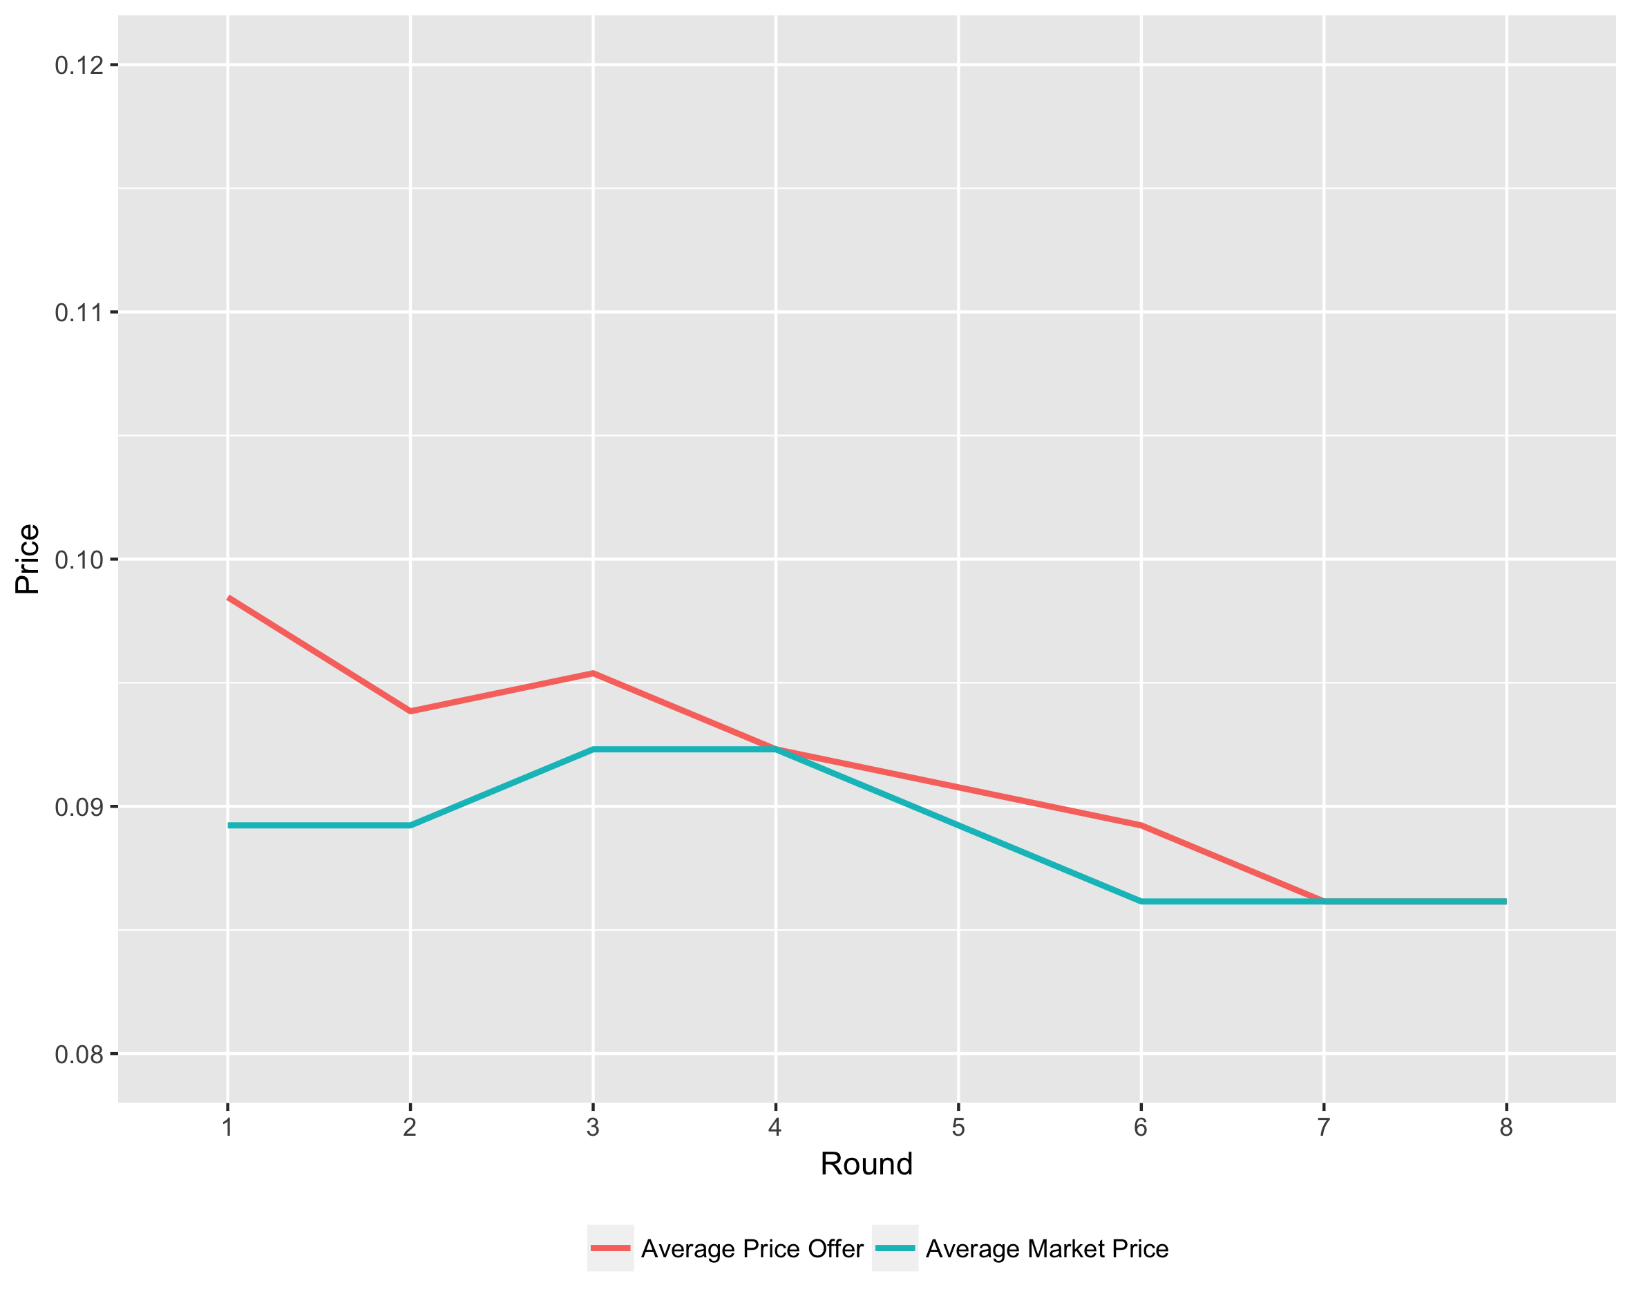
Experiment 14 – last term

Slide 8
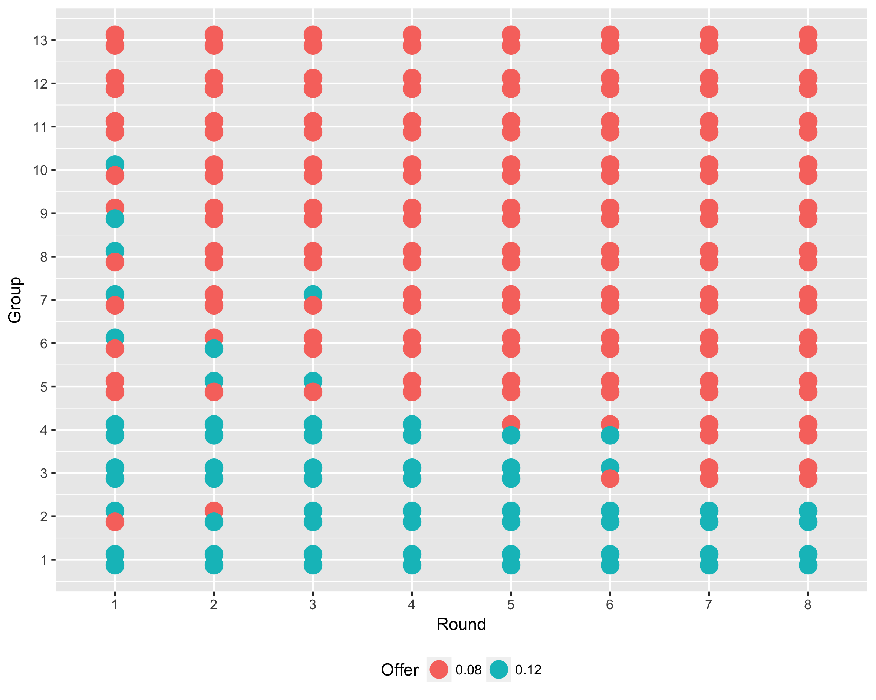
Experiment 14 – last term

Slide 9
Infinitely repeated games
Some players might have limited foresight such that they see a game as infinite
A game might actually be infinite, or has a certain continuation probability after each round
Does this change rational behavior in such games?
Yes:
Backward induction is not feasible anymore, thus arguments relying on rollback cannot be applied
Rather, each repetition of the game can be seen as having the same future prospects → solving for one round (under the shadow of the future!) should yield a solution for all rounds
Note: Playing the one-shot equilibrium in each round is still an equilibrium in the infinitely repeated game. But there are others now …

Slide 10
Infinitely Repeated games theorem
If a game G has a unique Nash equilibrium, then there exists a unique subgame perfect Nash equilibrium in the infinitely repeated game G(T∞) in which the Nash equilibrium of the game G is played in reach round t.

Slide 11
Infinitely repeated games
Player 2
How to interpret δ ?
Game continuation probability: with a probability of δ the game is continued. Thus, in expected terms, seen from today, the next game is played for amounts of δ · X, etc.
Discount factor: right now, money earned next year is less valuable to us than money earned today. So when a game is played infinitely, income from later rounds is less valuable than today’s income. 1 – δ is this loss of value for each round in the future, seen from today.
Product of both
Round 1
 | D | C
D | 2 2 | 1 6
C | 6 1 | 5 5
Player 1
Player 2
δ
Round 2
 | D | C
D | δ2 δ2 | δ1 δ6
C | δ6 δ1 | δ5 δ5
δ
Player 1
Player 2
δ
Round 3
 | D | C
D | δ²2 δ²2 | δ²1 δ²6
C | δ²6 δ²1 | δ²5 δ²5
Player 1
…

Slide 12
Infinitely repeated games
Let C, D, H, and L be the utility payoffs from a dilemma game, with H > C > D > L.
Let 0≤ p ≤1 be the probability that the game continues after a round. Let 0≤ d ≤1 be the discount factor per round. Let δ = p · d.
Player 2
 | D | C
D | D D | L H
C | H L | C C
Player 1
Define a Tit-for-tat strategy as: “I play C in the first round, and in each other round I play whatever the other player played before.”
Is mutual Tit-for-tat an equilibrium in this game?

Slide 13
Infinitely repeated games
Is one-time defection worthwhile?
If a player complies, then his net present value is
If a player defects once against T4T his net present value is
Player 2
 | D | C
D | D D | L H
C | H L | C C
Player 1
So he should one-time defect if
If loss from punishment (C-L) is large or benefit from defecting (H-C) is small or the next round has relatively high value, then one-time defection does not pay.

Slide 14
Infinitely repeated games
Is all-time defection worthwhile?
If a player complies, then his net present value is
If a player defects forever against T4T then his net present value is
Player 2
 | D | C
D | D D | L H
C | H L | C C
Player 1
So he should defect if
If loss from continued punishment (C-D) is high or one-time benefit from defection (H-C) is low or the future has a high value, then all-time defection does not pay.

Slide 15
Infinitely repeated games
Partially numerical example: δ=0.9
One-time defection if
→ If the gain from defecting today, compared to cooperation, H-C, is larger than the discounted loss from the T4T player’s punishment next round, 0.9(C-L), then I should defect once.
Player 2
 | D | C
D | D D | L H
C | H L | C C
Player 1
All-time defection if
→ If the gain from defecting today, compared to cooperation, H-C, is larger than the loss from mutual defection in the discounted remaining rounds (expected value=9), 9(C-D), then I should defect forever.

Slide 16
Infinitely repeated games
Folk Theorem (Friedman 1971):
Let G be a static n-person game with complete information. Let e = (e₁, ..., e_{n}) be the payoff vector in a Nash equilibrium of G and let x = (x₁, ..., x_{n}) be a feasible payoff vector in G, and let x_{i} > e_{i} for all players i .
If δ close enough to 1, then there exists a subgame perfect Nash equilibrium of the infinitely repeated game G(∞, δ ) which implements the payoff vector x als average payoff.
In other words: any feasible payoff combination (x₁, ..., x_{n}) (with x_{i} > e_{i} for all players i) can be implemented by some trigger strategies in an infinite game.

Slide 17
Infinitely repeated games
Player 2
What does that mean?
Payoff vectors
Feasible payoff vectors
with x_{i} > e_{i} for all players i
Folk theorem: Each point in the green area can be implemented as average payoff, by a) playing a combination plan over the 4 cells and b) threatening to always play (2,2) if somebody deviates from this plan
Note: (2,2) is a credible threat, as it is a stage game equilibrium, and worse than any payoff in the green area.
 | D | C
D | 2 2 | 1 6
C | 6 1 | 5 5
Player 1
(1,6)
6
(5,5)
Player 2
(2,2)
(6,1)
0
Player 1
6

