Slide 1
Experiment 13
Repeated price competition with 2 firms
  Derive all Nash equilibria for the one-shot game (game played only for one round). Prove for each equilibrium you found that it is indeed one. Show that there are no other equilibria.
  Derive the subgame perfect equilibrium for the 10-rounds repeated game.

Slide 2
Experiment 13
Player 2
 | 0.08 | 0.12
0.08 | 12 12 | 0 24
0.12 | 24 0 | 17.5 17.5
The Nash equilibrium of the one-shot game is:
  Player 1: Choose price of 0.08.
  Player 2: Choose price of 0.08.
*
Player 1
*
*
*

Slide 3
Experiment 13
The equilibrium of the repeated game (repeated with the same players) corresponds to playing the one-shot equilibrium in each repetition.
Why? Backward induction!
  In the very last repetition, what is the equilibrium of the game?
  The unique one-shot equilibrium! That means, behavior in the very last round is completely independent of any behavior before.
  Thus, in the second last round, as behavior has no impact on how players will behave in the last round, the game is played as if it is the last game.
  The same is true for the second-to-last round, etc.etc., until we arrive at the first round.

Slide 4
Recap: Finitely repeated games theorem
Theorem:
  If a game G has a unique subgame perfect Nash equilibrium, then there exists a unique subgame perfect Nash equilibrium in the finitely repeated game G(T) in which the subgame perfect Nash equilibrium of the game G is played in each repetition.
  Proof: We find the SPNE of the T times repeated game by rollback. The SPNE solution for the last repetition T will be the SPNE of the one-shot game. So play in the second-to-last repetition T-1 cannot change what comes after in T. As a result, the SPNE solution for the second-to-last repetition T-1 will also be the SPNE of the one-shot game. Etc. etc. until the first repetition.

Slide 5
Experiment 13
The subgame perfect Nash equilibrium of the repeated game is:
  Player 1: Choose price of 0.08 in each round.
  Player 2: Choose price of 0.08 in each round.

Slide 6
Experiment 13
What about punishing strategies. E.g. both play: “I start with a high price, but I will select a low price whenever I see the other selecting a low price?” Is this an equilibrium?
No:
  A best response to someone playing this strategy would be: I do the same, only that in the very last period I choose a low price.
  A best response against that would be to defect in the second-to-last period …. etc. etc.
Even if the other guy believes my punishing strategy, and plays cooperatively, I myself would have an incentive to choose another strategy.
→ Even in the repeated game, there is only one unique Nash equilibrium. There are no other Nash equilibria
(for example involving not credible threats or similar).

Slide 7
Experiment 13
Data
  Analyze the data set of experiment 13. What do people do? Can you observe specific patterns of behavior over time?

Slide 8
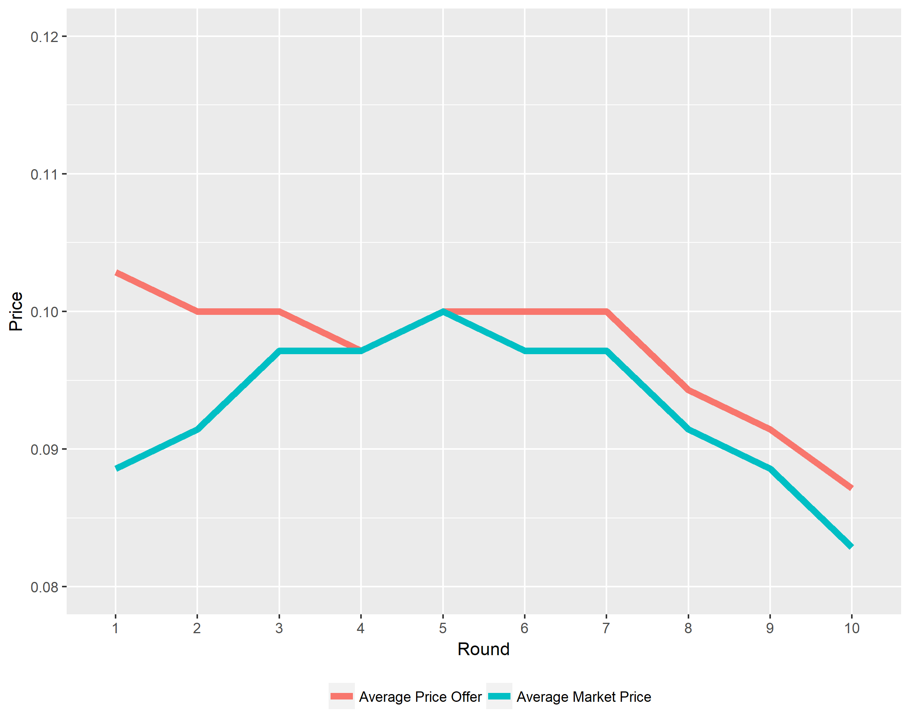
Experiment 13

Slide 9
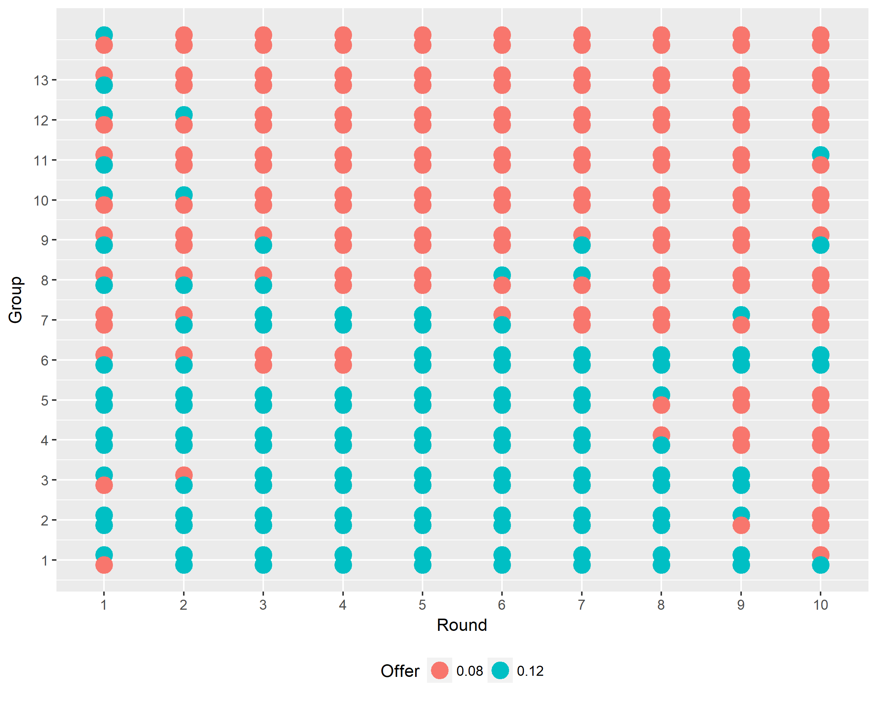
Experiment 13

Slide 10
Experiment 13
No cooperation

Slide 11
Experiment 13
Little cooperation in last round

Slide 12
Experiment 13
Some successful
cooperation attempts

Slide 13
Experiment 13
Tit for tat punishment

Slide 14
Experiment 13
Data
  Compare the results of theoretical and data analysis to experiment 2 (simultaneous price competition, conducted in tutorial 1 and analyzed in lecture 2). What are the most important differences between experiment 13 and experiment 2?

Slide 15
Experiment 13
For the competition game of experiment 2, we had a similar prediction of behavior as for the game of this experiment: all firms set the lowest price.
In experiment 2 we observed that this was indeed the case: already in the 1st round, the equilibrium price was reached, and most individual price offers were at the equilibrium in the 2nd round, with very few deviations.
In experiment 13, we observe more cooperation but still not much.
Generally speaking:
  Groups of 2: better coordination on collusion.
  Same partner in all rounds: potential of punishment!

